Slide 1
The Application of Model-Based Systems Engineering to Understand Security of Systems Using SAE J1939
Research Committee:
Jeremy Daily (Chair)
Daniel Herber
Bret Windom
Gabriel Salinger
January 26, 2024

Slide 2
Gabe Salinger
SE MS (Started Fall 22)
USAF Active Duty

Slide 3
Program Summary
Active Duty USAF Officer – 18 month timeline for program completion (PCS Feb 2024)
Fall 2022: SYSE 501 Foundation SE, ENGR 502 Project Mgmt, SYSE 580A3 Aerospace Actuators – COMPLETE​
Spring 2023: SYSE 549 Secure Vehicle Networking, SYSE 569 Cyber Awareness for SE, SYSE 695 Independent study MBSE– COMPLETE​
Summer 2023: SYSE 699 Thesis Research COMPLETE,
Fall 2023: SYSE 532 Dynamics of complex systems, SYSE 699 Thesis Research – COMPLETE​
GS6 Completed and approved​
Spring 2024: Thesis – COMPLETE
Jan 2024: Defend and Graduate!
PCS on Feb 26 2024
Research Productivity:
1 First Author Peer Reviewed Conference Paper
1 Co-Author Peer Reviewed Journal Paper
3 Scholarly Presentations

Slide 4
Research Overview
Introduction and Motivation
Literature Overview
Research Questions
Contributions

Slide 5
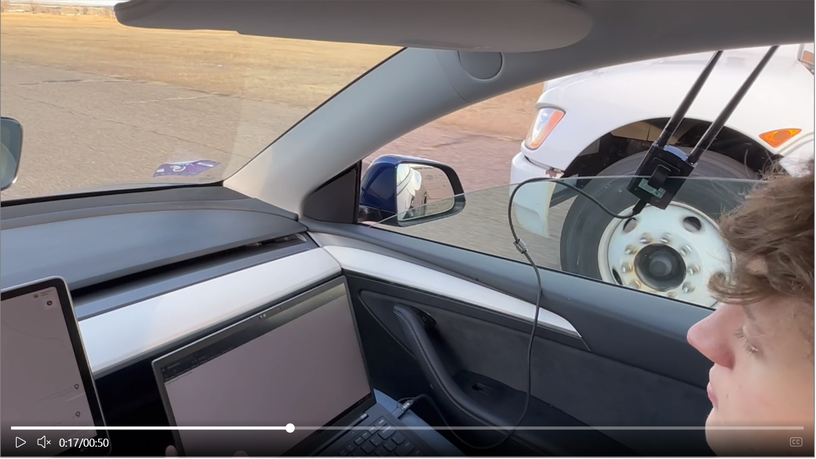
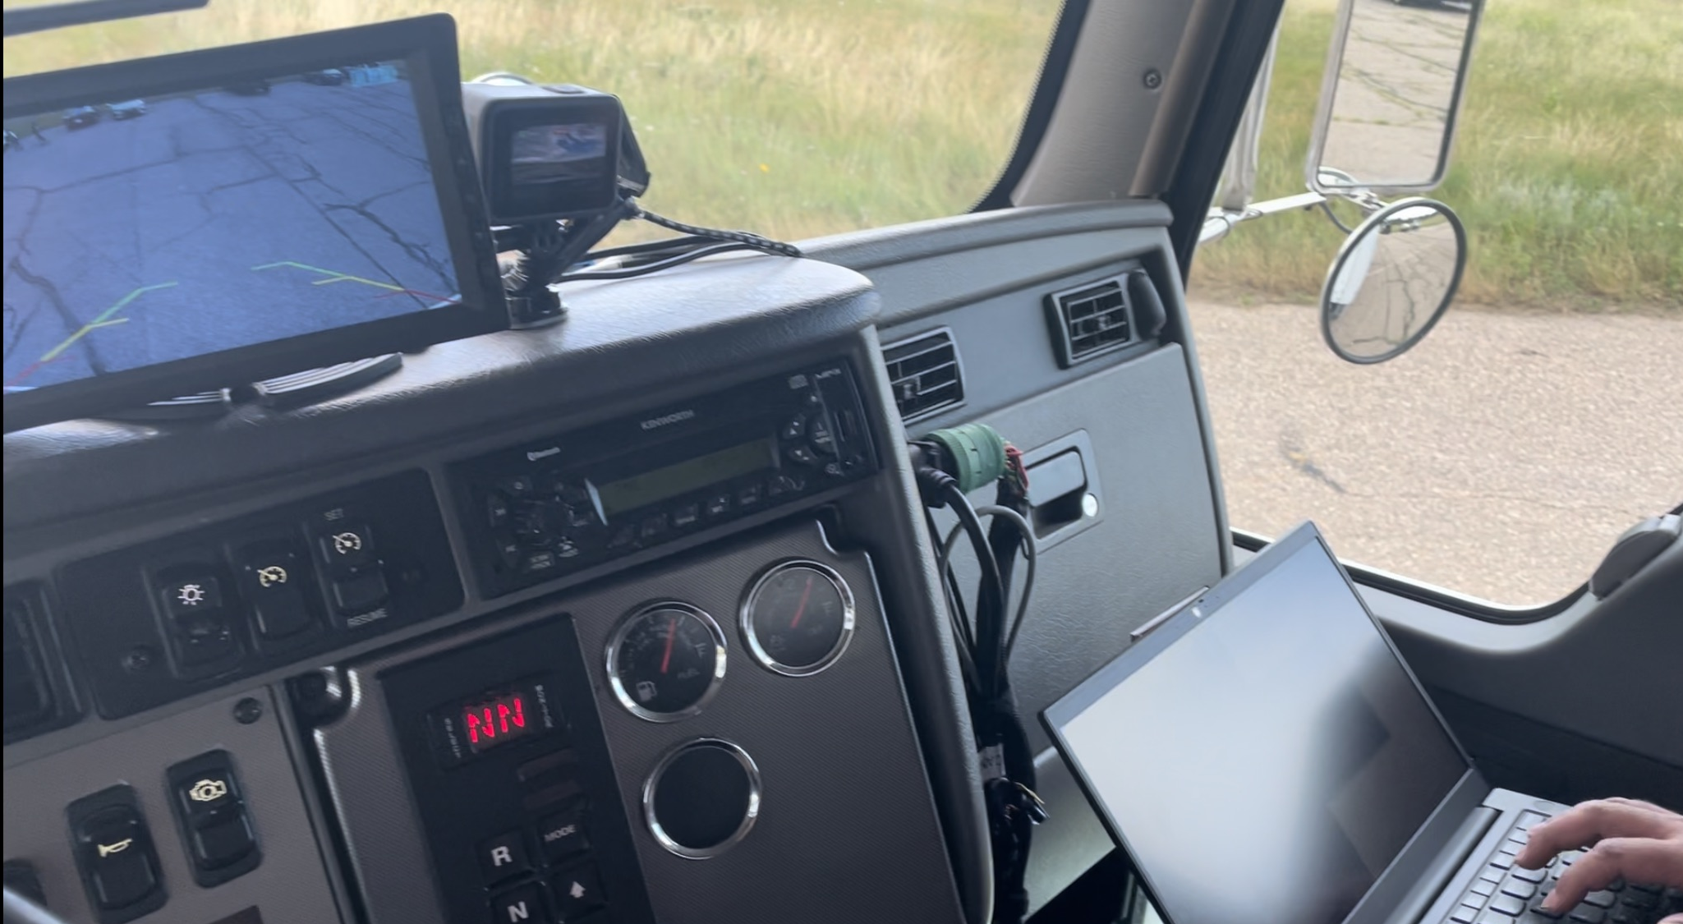
Problem Overview
Vehicle security has become an underrepresented and important factor in the cybersecurity domain
New exploits have been discovered and validated in MHD truck networks [1],[2]
The Department of Defense has highlighted the need for cyber-physical system design that employs digital engineering tools [3]
Acknowledged need to improve Cybersecurity by Design
Cybersecurity is an emergent property
The complexity of modern systems requires a well documented process with effective traceability and iteration capabilities
Systems Engineering must play a key role in secure system design
Introduction and Motivation
Notes:
Key points:
- Acknowledged need for system design using digital engineering
- Need a way to manage the complexity of systems through a well documented process

Slide 6
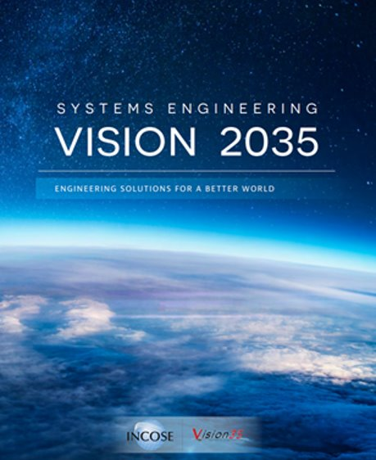
Research Motivation
“Cybersecurity will be as foundational a perspective in systems design as system performance and safety are today” (INCOSE Vision 2035 p.37) [4]
“Systems engineering provides the basic foundation for a disciplined approach to engineering today’s trustworthy systems” -- NIST SP 800-160 v1 [5]
Communication across engineering disciplines, completeness of design, and well-traced documentation can all be addressed through Model Based Systems Engineering [6]
1972 Anderson Report “Unless security is designed into a system from its inception, there is little chance that it can be made secure by retrofit…”
https://www.incose.org/2023_redesign/publications/se-vision-2035
Introduction and Motivation

Slide 7
Overview
Introduction and Motivation
Literature Overview
Research Questions
Contributions

Slide 8
Literature Review
Total References: 67
Literature Overview

Slide 9
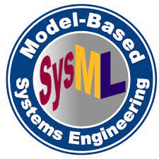
Model Based Systems Engineering Overview
The role of MBSE is to capture and guide the system design through the development of a system model
The three core MBSE pillars are [7]:
Modeling language
Defines the elements, relationships, and visual aspects of the diagram
Modeling tool
Authoring software that implements the rules for modeling and visualization based on modeling languages to create and manipulate the model
Modeling method
Provides guidance and a structure that defines what needs to be modeled, at which stages in the process, and how to do it (Techniques).
Must use all three pillars for successful modeling!
Literature Overview

Slide 10
Model Based Systems Engineering Methods for Security
UMLSec, 2002 [8]
UML Sec uses standard UML diagrams to specify security requirements and attack scenarios. It provides a set of security-related constructs, such as security classes, associations, and constraints.
SysMLSec, 2015 [24]
The SysML process involves developing high-level security requirements, analyzing attack trees and ending with hardware and software partitioning.
CHASSIS, 2013 [25]
Relies on UML-based diagrams and text-based techniques to develop functional safety/security requirements.
MBSEsec, 2020 [26]
MBSEsec is a method for developing secure systems through developing a detailed systems model that outputs security controls.
MBSEsec is the most up-to-date and most relevant, because it is a combination of best practices
Literature Overview

Slide 11
Overview
Introduction and Motivation
Literature Overview
Research Questions
Contributions

Slide 12
Research Questions
RQ1: How can security be incorporated into the system development process using MBSE?
RQ2: How can MBSE be leveraged to conduct security requirement elicitation in the design of secure systems?

Slide 13
Research Question 1:
How can security be incorporated into the system development process using MBSE?
Motivation: INCOSE Vision 2035 states that “The Future of Systems Engineering Is Predominantly Model-Based” (p.33), and that “Cybersecurity will be as foundational a perspective in systems design as system performance and safety are today” (p. 37).
Research Tasks:
1.1 Develop an understanding of systems modeling (SysML in Cameo) and of the system of interest: Truck Networks
1.2 Build a simulation of real time network attacks (SysML) and investigate benefits
1.3 Investigate what methods exist that incorporate MBSE to develop more secure systems
1.3.1 Investigate literature, methods, applications and tools related to: SE, MBSE, Security Requirements Engineering, and primary security-related systems engineering standards
1.4 Demonstrate the utility/applicability of selected security MBSE approach to truck networks
1.5 Evaluate the approach, highlighting its benefits, and shortcomings
Output: J1939 Network attack simulation, demonstrated utility and value of an MBSE method for secure system development
Research Question #1
13

Slide 14
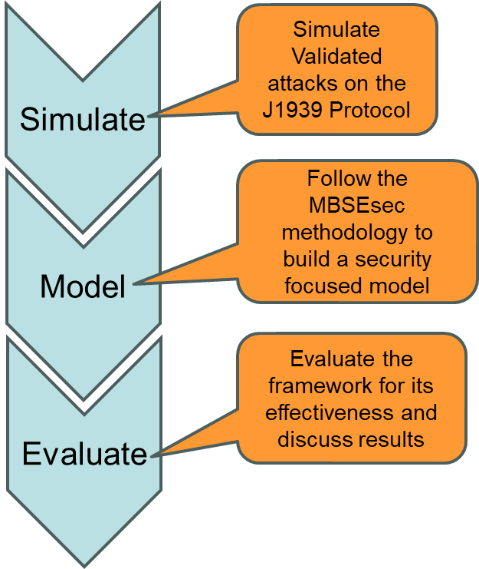
RQ1 Approach:
How can security be incorporated into the system development process using MBSE?
Explore the effectiveness of a selected MBSE method to securing a system with validated exploits
System of Interest: J1939 Transport Protocol
This is accomplished by:
Developing an understanding of the J1939 transport protocol and its exploits using SysML simulation
Develop a model following a prescriptive MBSE method
Use the method to develop security controls for the system of interest
Evaluate its effectiveness
Providing recommendations
Research Question #1
14

Slide 15
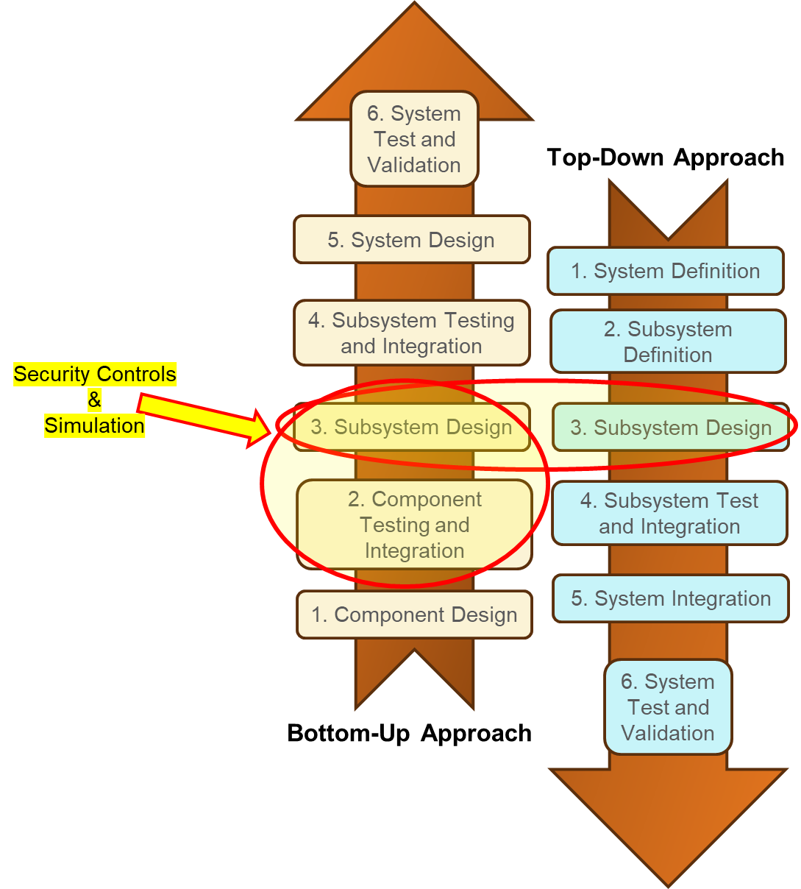
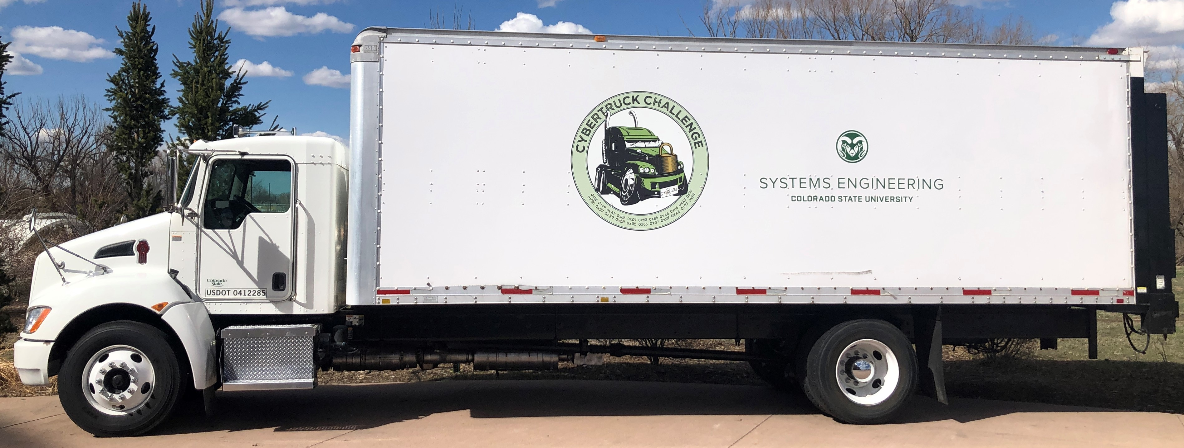
How effective is MBSE simulation?
In MBSE with/out Simulation: State of the Art and Way Forward, Zeigler et al. [31] highlight that the absence of proper modeling and simulation infrastructure creates gaps in our understanding of complex engineering systems.
Objective: Explore the benefits of simulation using model-based tools to better understand complex systems, and bridge the gap between bottom up and top down approaches.
Investigated by modeling attacks on the J1939 network protocol that have been validated on the Lab’s research truck
2014 Kenworth T270 medium-duty truck
Research Question #1
15

Slide 16
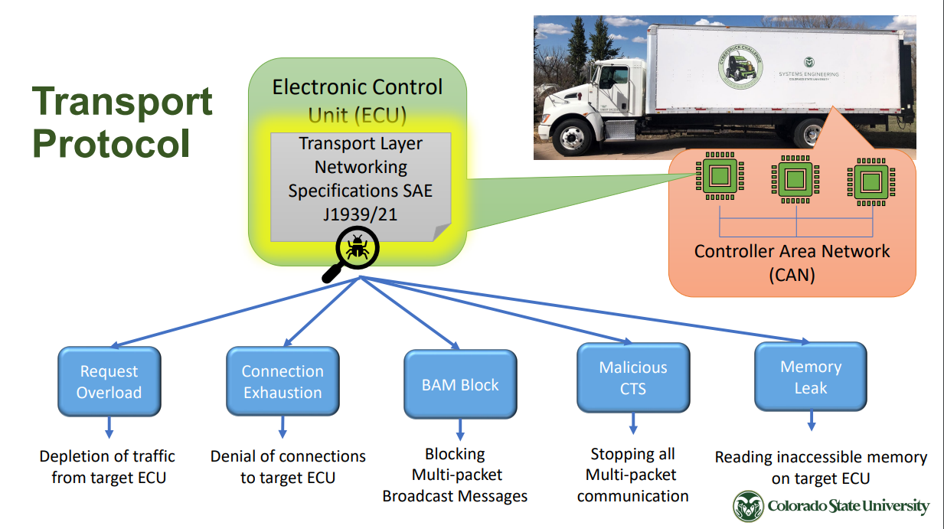
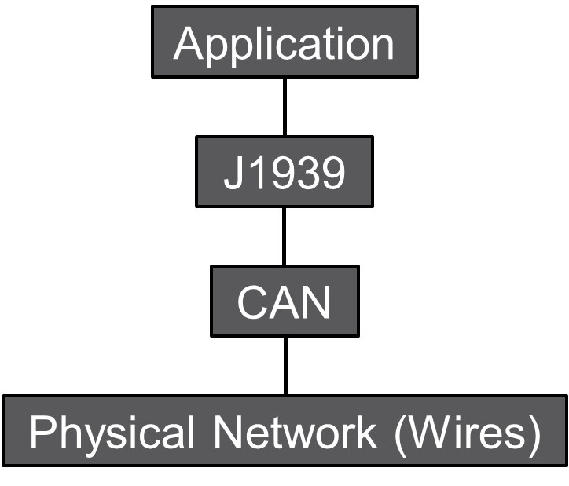
Understanding the System of Interest: J1939 Protocol
Simulated in SysML
Graphic taken from: R. Chatterjee, S. Mukherjee, and J. Daily, “Exploiting Transport Protocol Vulnerabilities in SAE J1939 Networks,” in Proceedings Inaugural International Symposium on Vehicle Security & Privacy. San Diego, CA, USA: Internet Society, 2023.
Research Question #1
16
Notes:
J1939: Defines how information is transferred across a network to allow ECUs to communicate information (e.g. vehicle speed)
J1939 is a ‘software specification’ that operates on top of a CAN bus.
CAN (Controller Area Network) is a form of serial communication used on heavy vehicles

Slide 17
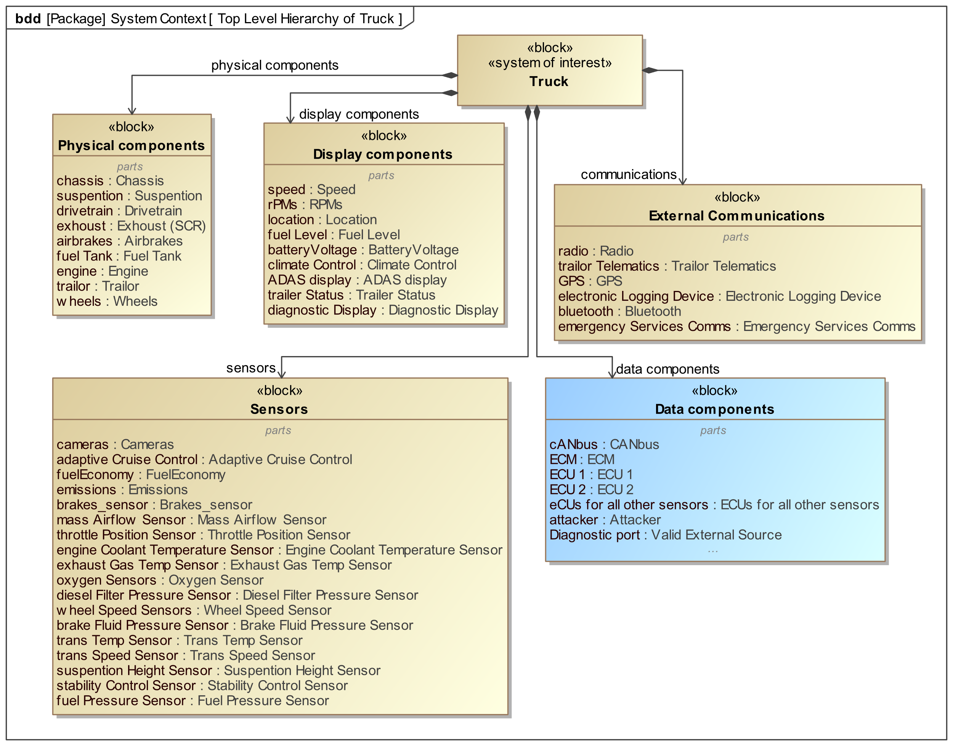
System Context
Captures the context in which the protocol is used
Block definition diagram was developed to identify external elements to the system
Frames the context in which the simulation takes place.
Research Question #1
17

Slide 18
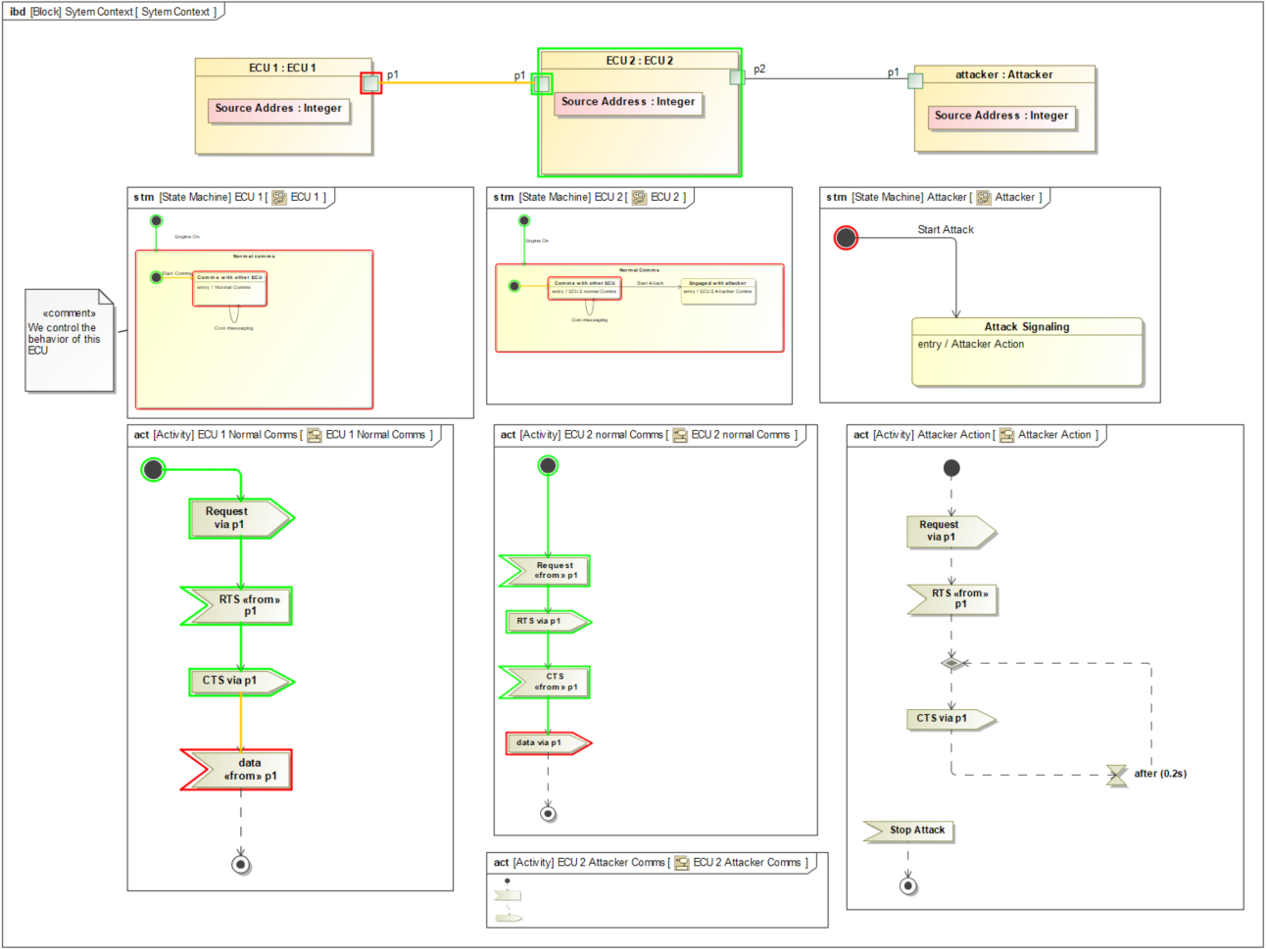
Simulation of attack – Connection Exhaustion Attack
Block Definition Diagram – Truck Subsystem hierarchy
Internal Block Diagram – Network component information flow/behavior
Sequence Diagram – Network Messaging
Block Definition Diagram – Developed to give context to the simulation
Models the primary subsystems of a typical truck
Gives context to the SOI: J1939 components (ECUs)
Internal Block Diagram – Models the flows between blocks
State machine and activity diagrams drive the behavior of the blocks (ECUs)
Sequence Diagram – Artifact, portrays the execution of the connection exhaustion attack
Validates the model works
Provides a clear demonstration of how the attack takes place
Normal Comms
Attack Sequence
Research Question #1
18
Notes:
Here, we build a model that simulates the network messages that take place during a connection exhaustion attack
First, a block definition diagram was developed that provides context for the system of interest
- the key subsystems were elaborated: Like Physical components, sensors, data components, external communications
Next an internal block diagram was developed to model the flows between blocks. State machine diagrams and activity diagrams were used to characterize the ECU and attacker the behavior
As can be seen, the IBD is comprised of two ECUs and an Attacker. This is all that was needed to illustrate the attack.
As the model is simulated, a sequence diagram is developed that illustrates the sequence of messages between the ECUs.
- This helps validate that the model was built correctly.

Slide 19
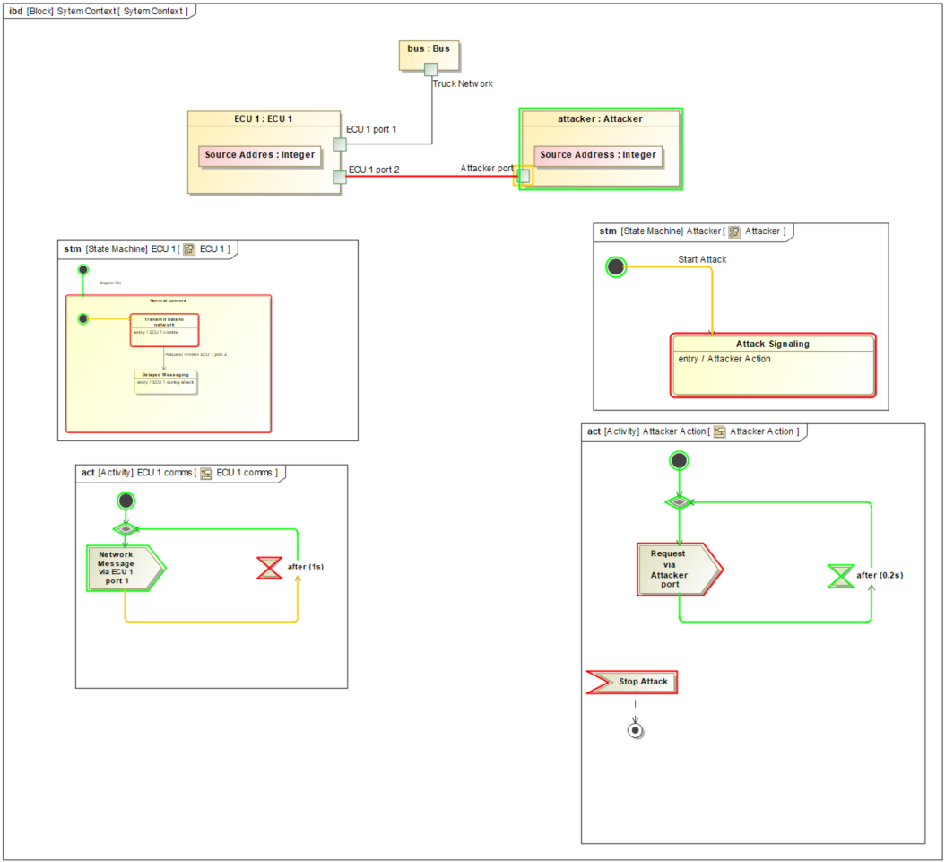
Simulation of attack – Request Overload Attack
Block Definition Diagram – Truck Subsystem hierarchy
Internal Block Diagram – Network component information flow/behavior
Sequence Diagram – Network Messaging
Benefits of simulation modeling:
1. Used to help understand the problem (demonstrate the vulnerability)
2. Used for collaboration when brainstorming solutions
3. Helps bridge the gap between stakeholders and SMEs
Normal Comms
Attack Sequence
Research Question #1
19
Notes:
This slide demonstrates the Request Overload Attack
The key benefits from the simulations are:
Building these models helped the systems engineer get a better understanding of the SOI. Forcing him to learn the ‘component’ of the system
This model can be used for collaboration purposes, and talking through how the attacks take pace -> Brainstorming solutions
This model helps bridge the gab between stakeholders and subject matter experts

Slide 20
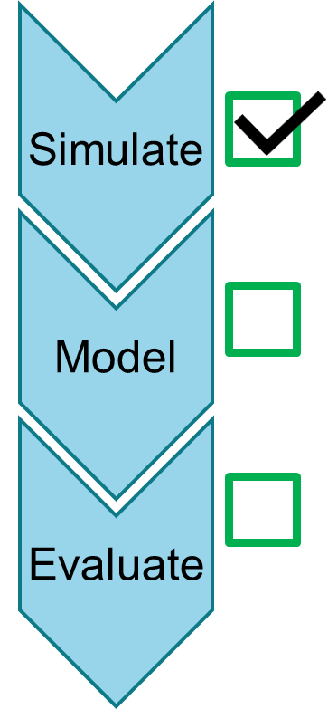
Conclusions from Simulation
Enhanced Collaboration:
Acts as a bridge between stakeholders and subject-matter experts, provides a common language and platform.
The simulations can visually highlight issues, making complex concepts accessible to both technical and non-technical stakeholders
Decision Making Support:
Provides easy-to-understand visualizations that helps stakeholders to gain deeper insights into potential threats
Facilitates more informed decision making and solution generation
Research Question #1
20

Slide 21
Now we will use a selected method to generate solutions for the demonstrated vulnerabilities
Research Question #1
21

Slide 22
Selected Method: MBSEsec
Developed by Mazeika et al. in 2020 [26]
Follows a simple four step iterative process
Research Question #1
22

Slide 23
Goal: Apply the MBSEsec methodology (Method) using SysML (Language) in Cameo (Tool) to the J1939 Transport Protocol (SOI).
Output: Security requirements, and security controls
Method
Language
Tool
Research Question #1
23

Slide 24
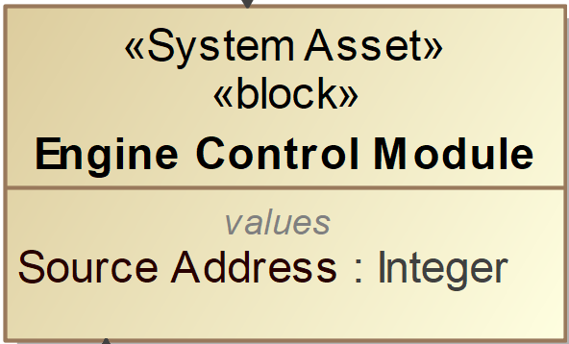
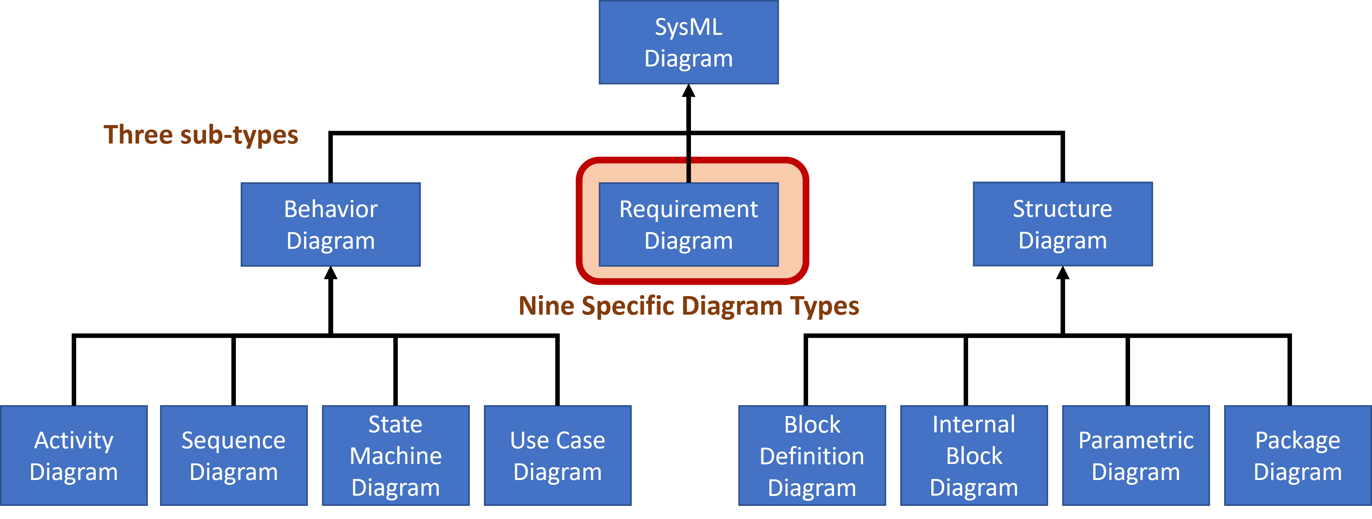
Some Key Concepts
Stereotype: Extends existing SysML profile and language concepts with additional properties and constraints. They add new language concepts, typically to support a specific application domain.
Literature Overview

Slide 25
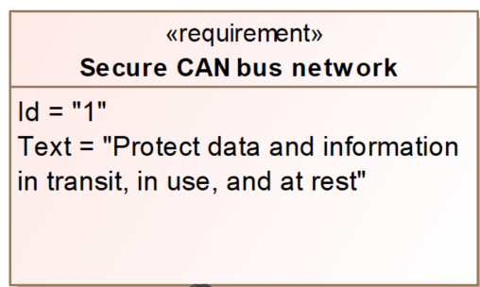
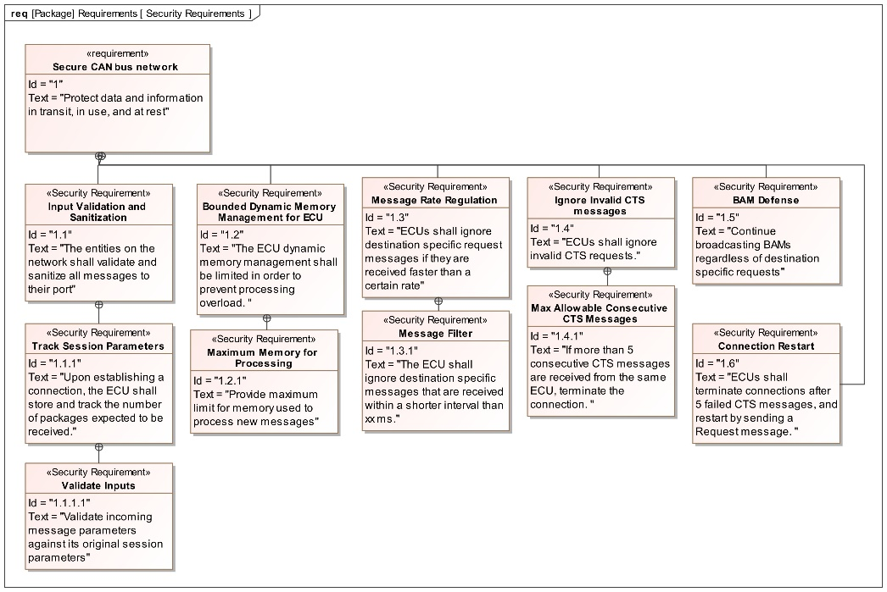
MBSEsec Applied
Identify Security Requirements
Targeted security requirements to reduce risk of the proven exploits
Requirements tailored to ensure mitigation of Denial-of-Service attacks and prevention of memory overload attacks
The discovered vulnerabilities highlight the fact that the ECUs are the system assets that must be secured
Incomplete specification leads to undefined behavior
Requirements focused on ECU behavior and message handling
Requirements Diagram
Research Question #1
25
Notes:
Identify Security Requirements
Phase 1: security requirements are identified alongside functional and non-functional requirements during the early stages of model development.
This process involves using a "Security Requirement" stereotype, a subtype of SysML Requirement, and utilizing standard SysML Requirements diagrams or tables.
Figure on the right: This is the requirements diagram that was developed for the J1939 protocol on the ECUs. Here we are using a Requirement Diagram

Slide 26
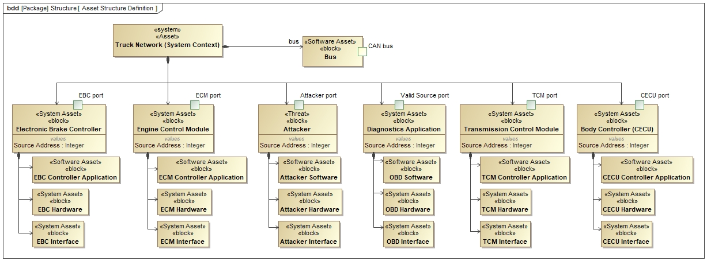
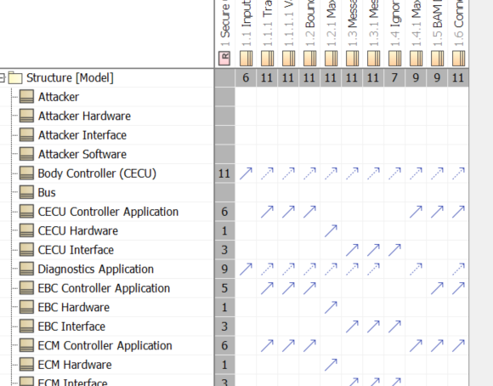
MBSEsec Applied Cont.
Capture and Allocate Assets
To best model the structure of the system, standard network traffic from the CAN Bus was logged
Message traffic highlighted primary ECUs
Diagram that represents the structure of the Network
Blocks to depict the entities, and parts to illustrate the important components (i.e. ECM Software)
Assets were classified using stereotypes defined in the MBSEsec profile (System asset, Software asset)
Then, the security requirements were allocated to the appropriate system assets.
Asset Structure Definition Diagram
Allocation Matrix
Allocation
Assets to requirements
Added an Attacker block to the diagram to:
Facilitates the principle of zero trust
Further elaboration of the behavior diagrams and misuse cases
Research Question #1
26
Notes:
Capture and Allocate Assets:
Phase 2: The focus is on defining the objects that need to be secured. The emphasis is on representing structure rather than usage or internal connections. Asset Structure Definition was used, which is a simple extension of the Block Definition Diagram. Using MBSEsec Stereotypes the model was elaborated.
In order to know which ECUs were of primary importance on the network, real time network traffic was logged, and the primary ECUs were added to the asset definition diagram.
System blocks were characterized using the prescribed stereotypes from the MBSEsec method.
System assets were then allocated to the appropriate security requirements, ensuring that all were met.
Attacker element was added: Although not a part of the MBSEsec methodology, we added an attacker to the model due to the given compromised state of the system. This was done to facilitate the incorporation of zero trust, and enable further elaboration of the model.

Slide 27
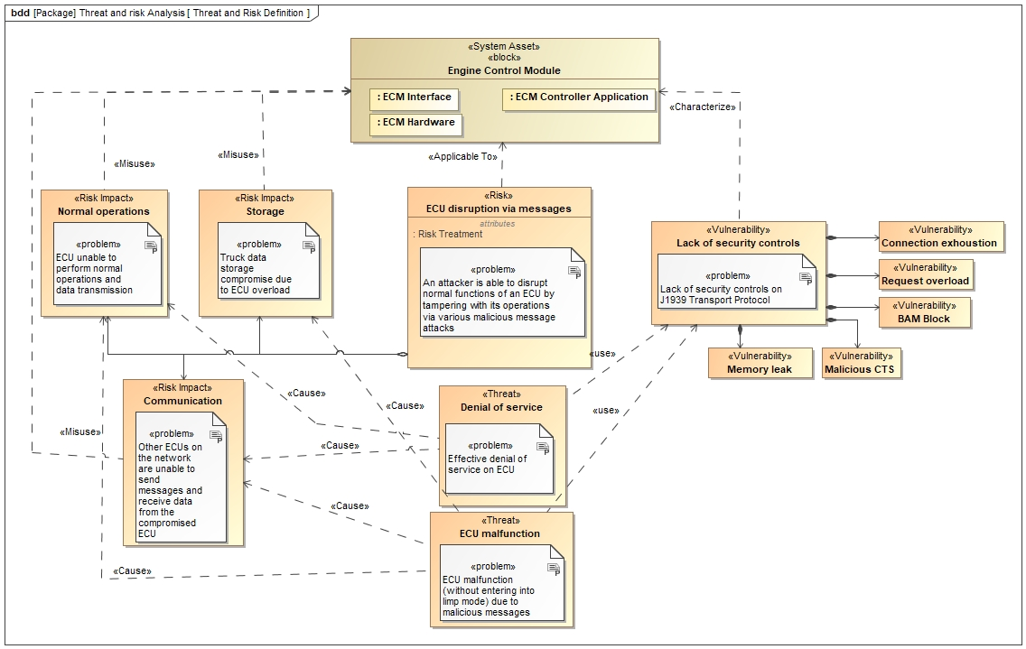
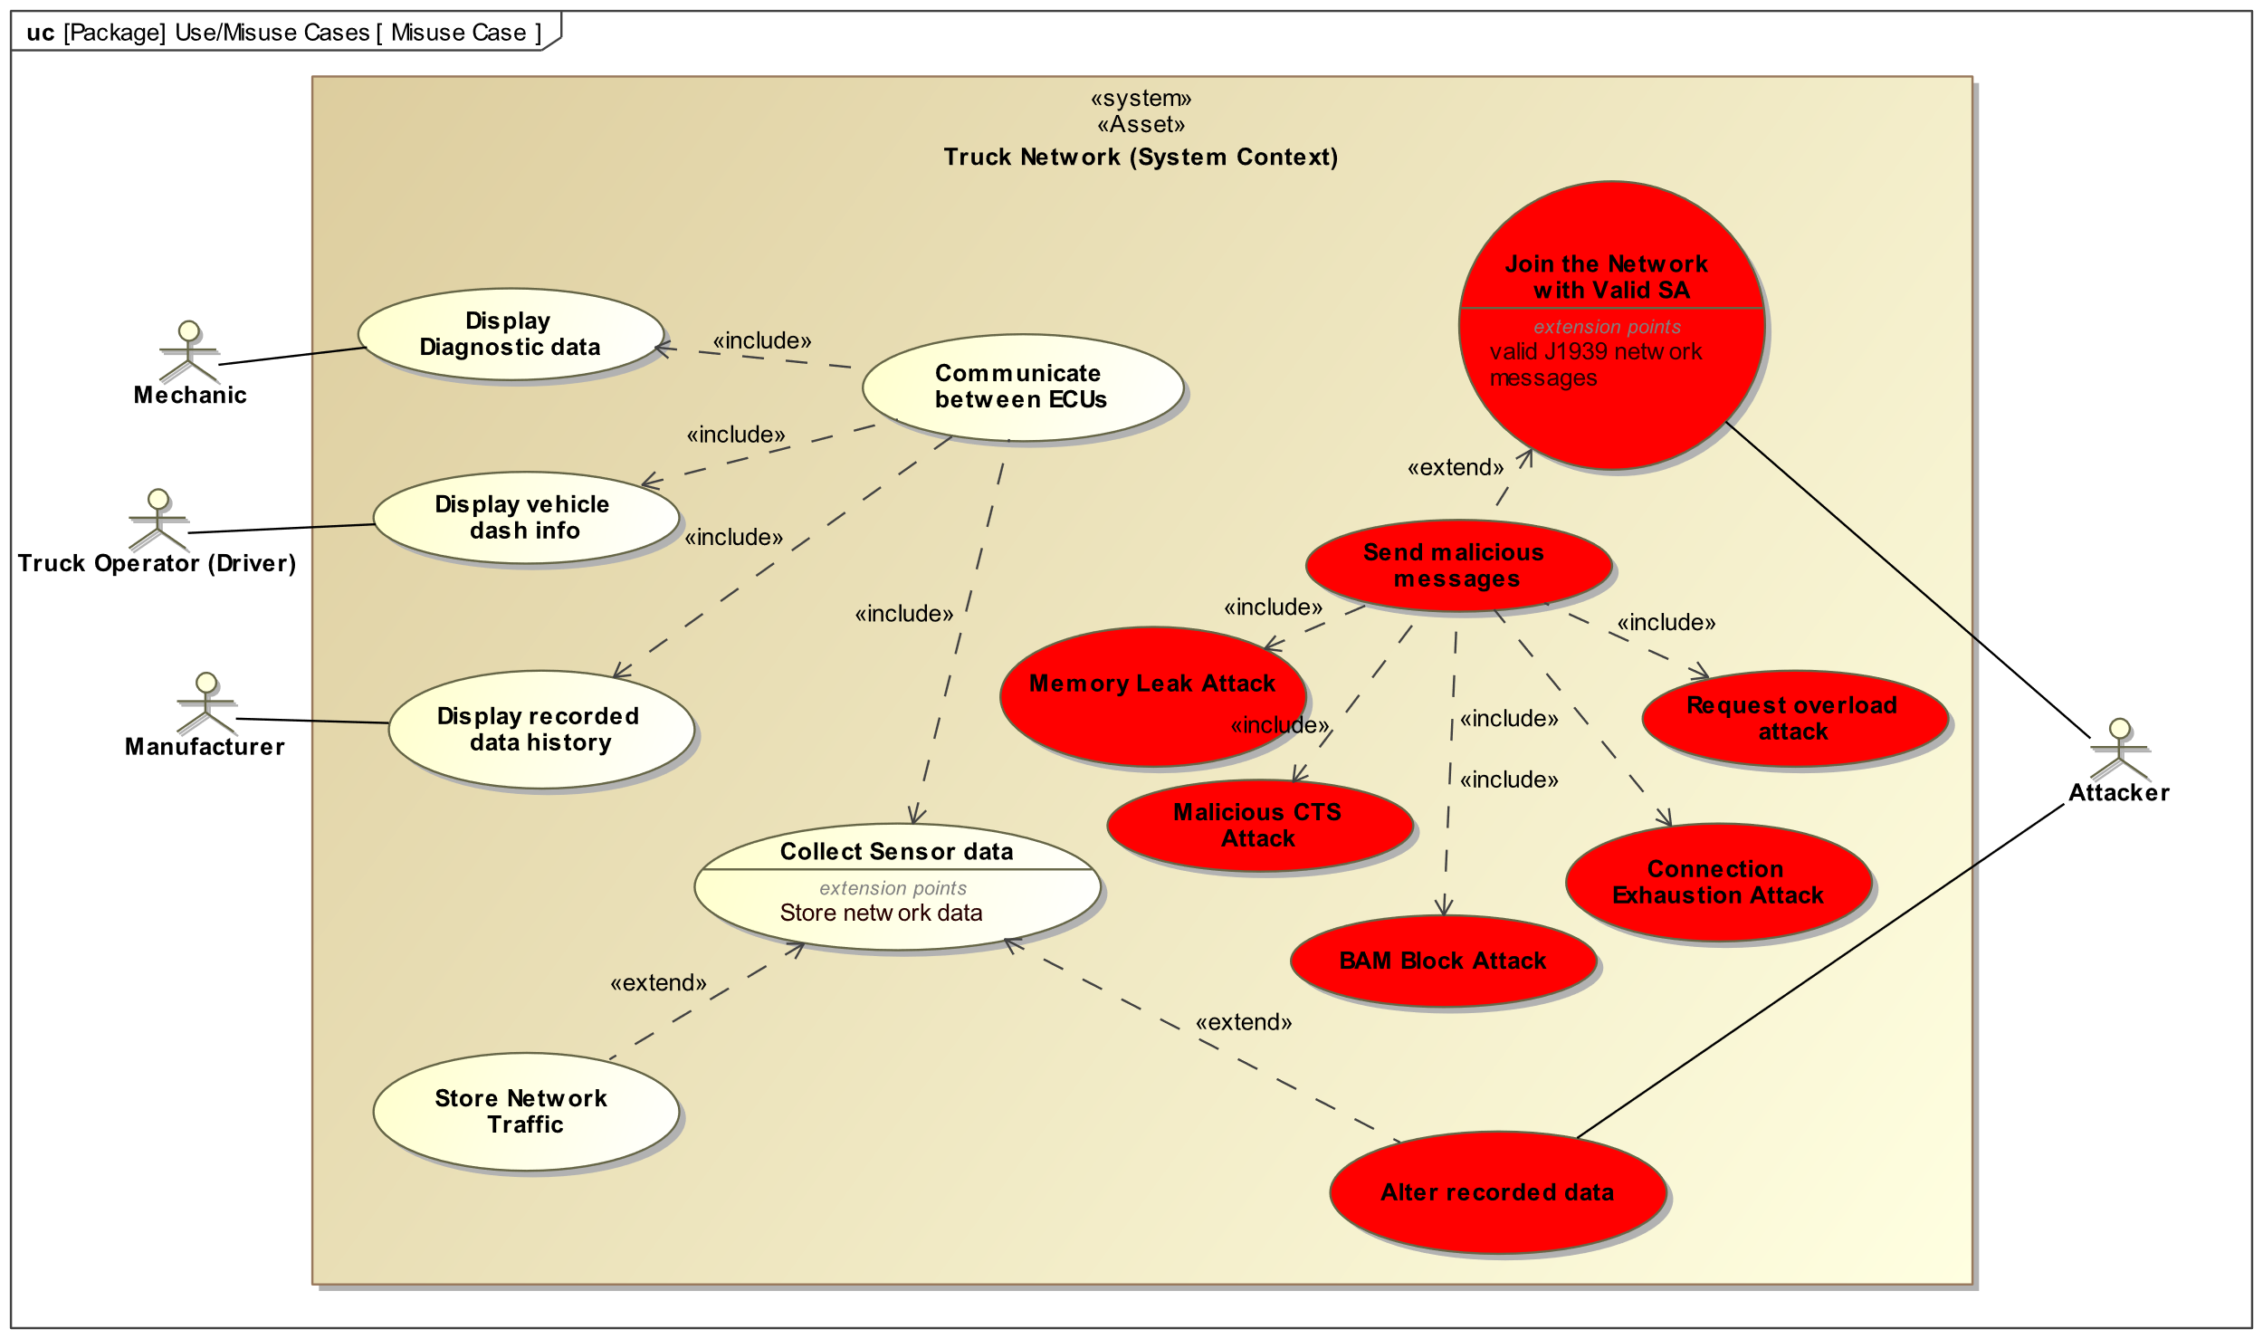
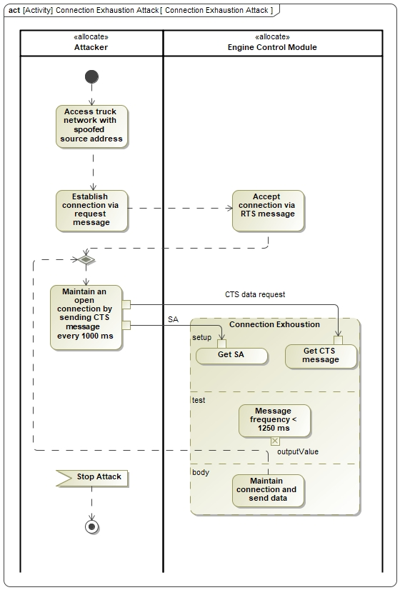
MBSEsec Applied Cont.
Structural Risk Definition
Behavioral Risk Definition
Threat and Risk Definition Diagram
Misuse Case Diagram
Model Threats and Risks
Consists of modeling both behavioral and structural security specifications
Behavioral risk definition: Misuse case diagram elaborated with activity diagrams
Structural risk definition: Risk Definition Diagram (Vulnerability, Threat, Risk, Risk Impact, Risk Treatment)
Overall system risk: ”An attacker is able to disrupt normal functions of an ECU by tampering with its operations using various malicious message attacks”
Primary vulnerability: “Lack of security controls on the J1939 Transport Protocol”
Activity Diagram
Research Question #1
27
Notes:
Model Threats and risks:
Phase 3: There are two aspects to threat and risk modeling: behavioral and structural security specification. For behavioral aspects, the Misuse Cases and Activity diagrams were used. The structural aspect involves the Threat and Risk Definition diagram, based on the UML Class diagram, where elements like Risk, Risk Treatment, Risk Impact, Threat, and Vulnerability are created and linked.
Figures on the right: The misuse case diagram is an extension of the Misuse case diagram, which illustrated how the attacker can misuse the system. Each misuse case is elaborated with an activity diagram that demonstrates how this takes place.
Threat and risk Definition Diagram: This diagram defines the system risk, and elaborates on the key security aspects such as vulnerability, threats, and risk impact. The elements are linked through relations such as ‘characterizes’, ‘use’, cause’, and ‘misuse’
Top level risks and vulnerabilities are defined on the slide.

Slide 28
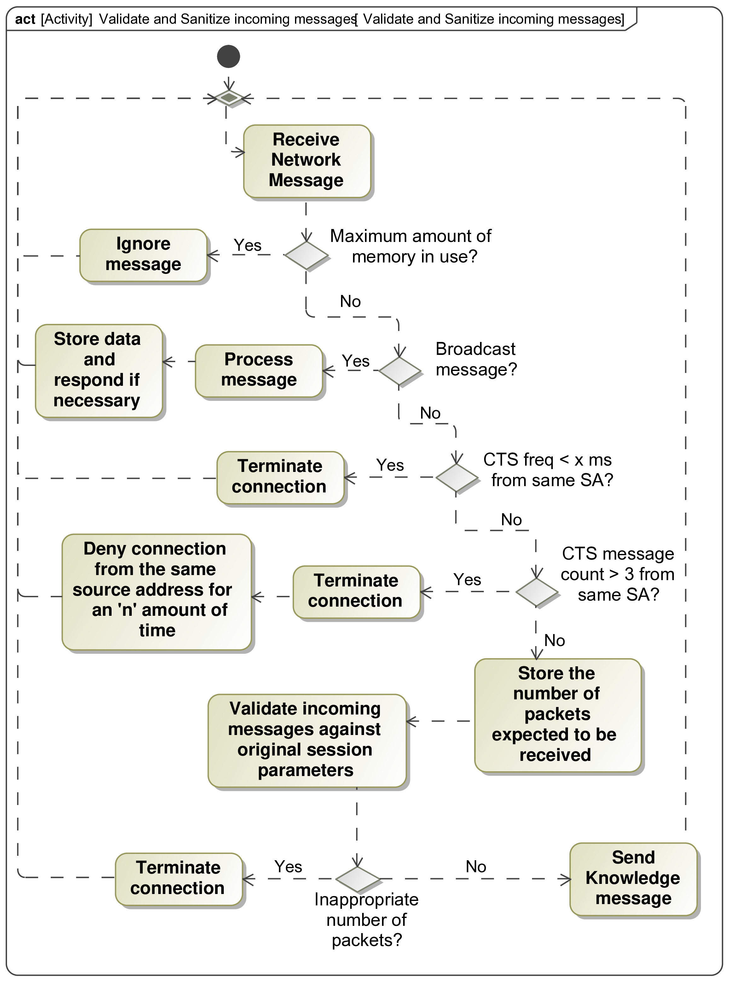
MBSEsec Applied Cont.
Decide Objectives and Controls
Involves developing a risk mitigation approach by creating security controls
Overall Security Objective: “Defend against transport protocol attacks”
Security controls in the form of activity diagrams were developed to meet the security requirements and objectives
Validate and Sanitize incoming messages
BAM Block Defense
Security Objectives and Control diagram was created
Relating control behaviors to control objectives
Behavior Diagram
Suggested a method that would make the ECU input parser more robust
Research Question #1
28
Notes:
Decide objectives and controls:
Phase 4: The focus is on defining security controls. This is achieved by utilizing a "Security Objectives and Controls Structure diagram," which extends the UML Class diagram, to define the elements related to security objectives and controls.
Activity Diagrams were used for identifying workflow or algorithms for security controls.
Diagram on right: This is a Behavior diagram illustrating the ‘validate incoming messages’ security control

Slide 29
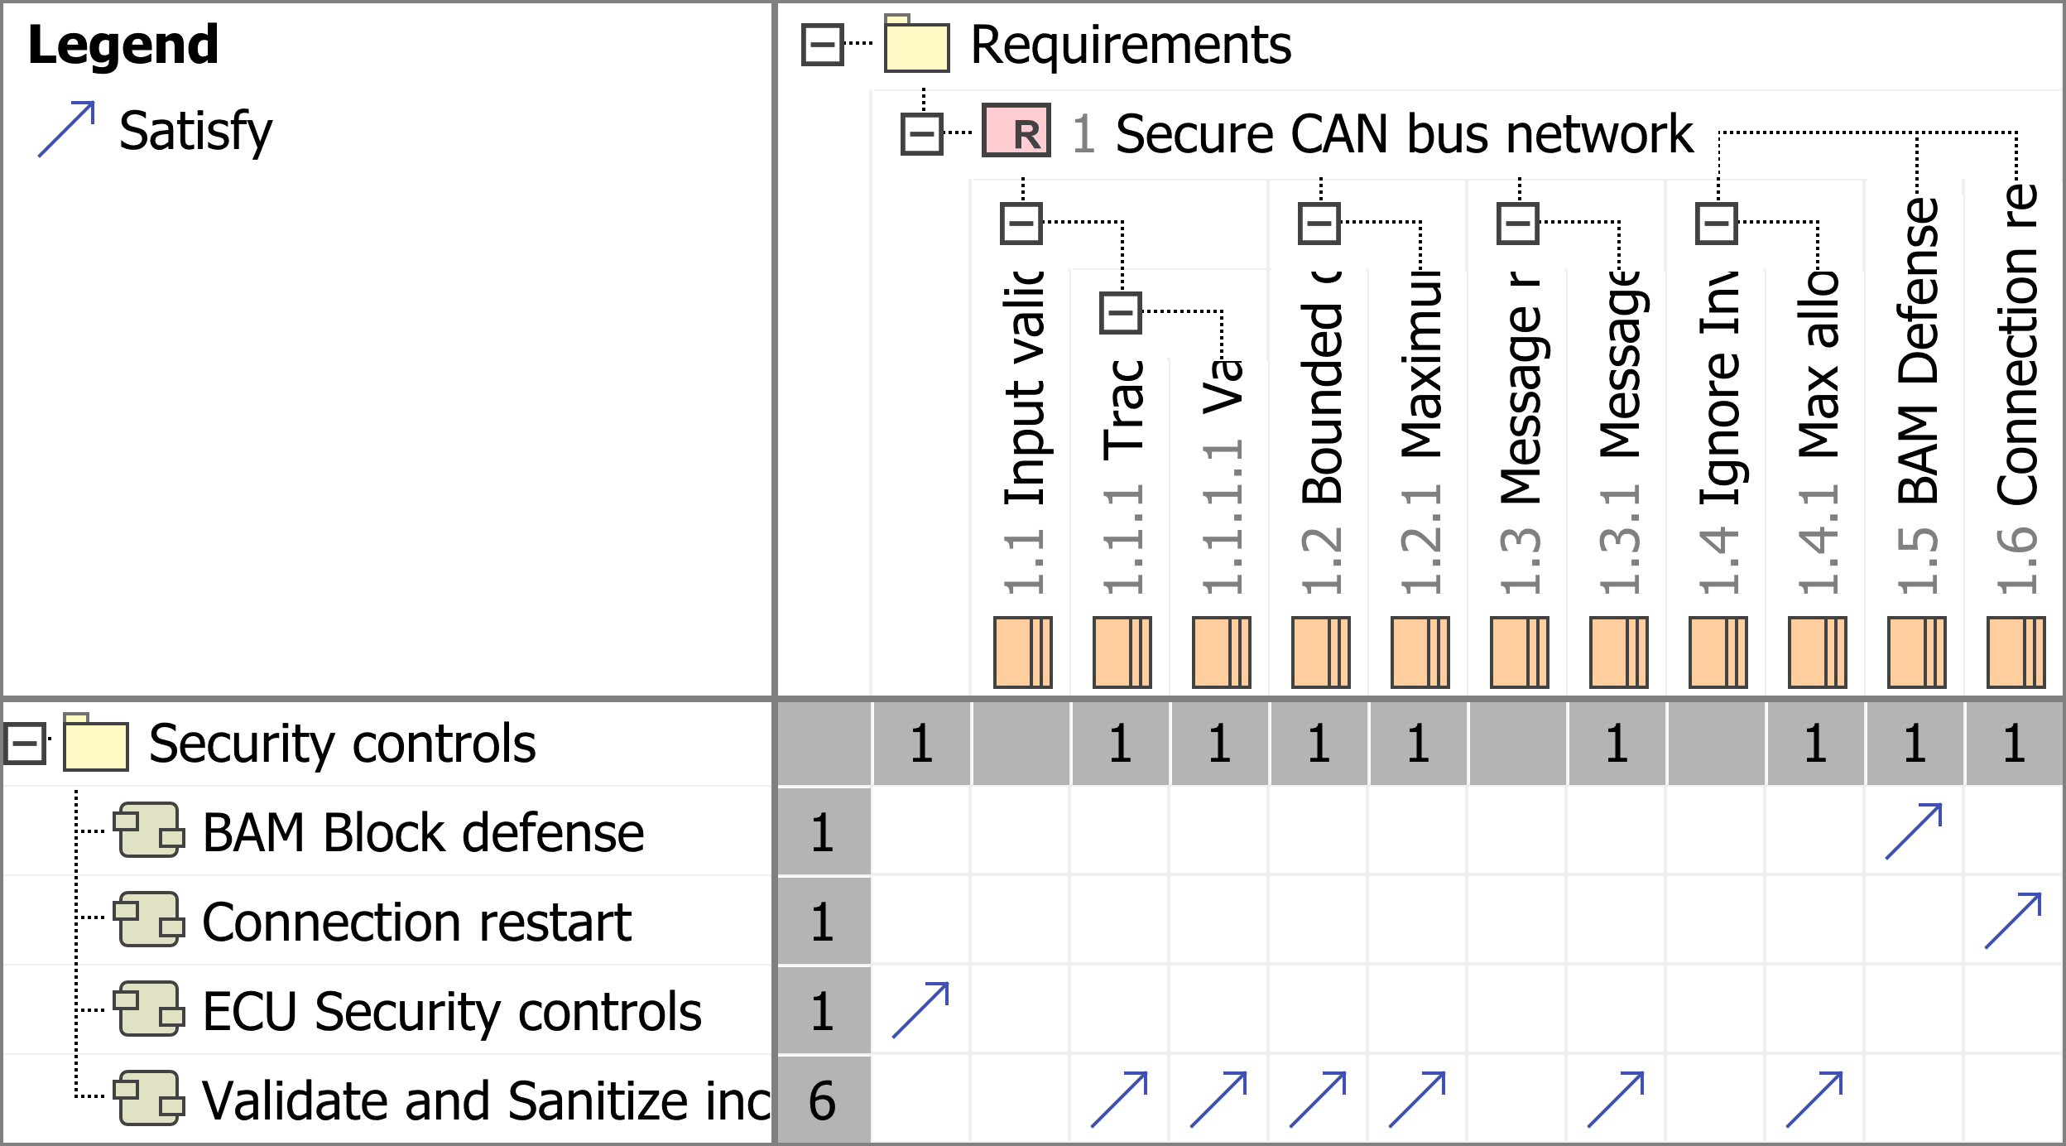
Verification and Satisfaction Checks
Security Requirements
Activity Diagrams
Security Controls to Security Requirements
** All requirements are met
Research Question #1
29
Notes:
Here we can see that allocation is very beneficial. Mapping security controls to requirements ensures that all requirements are satisfied with a security control.

Slide 30
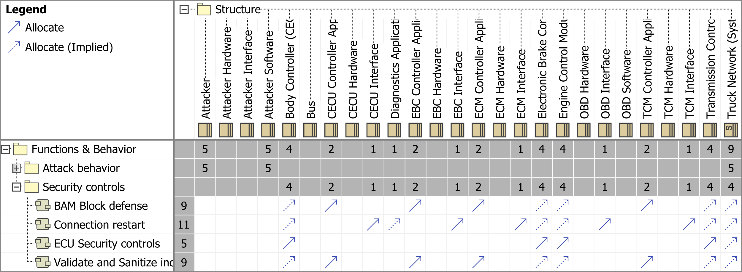
Verification and Satisfaction Checks
Security Controls to System Assets (components)
** Security controls allocated to appropriate System Assets
Research Question #1
30
Notes:
Another allocation matrix that is used to allocate the security controls to the appropriate system blocks.

Slide 31
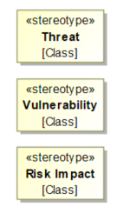
Discussion of Results
We applied MBSEsec to a new domain: Heavy vehicle network protocols.
Developed security controls in the form of activity diagrams
Security requirements were iteratively updated when modeling threats and risks: Simple with MBSE
Easy iteration and model updates due to MBSEsec structure, and the dynamic nature of MBSE
Applying the MBSEsec profile (Stereotypes) to model elements emphasized the system's security aspects
The model enhanced traceability
Brainstorming solutions for the vulnerabilities were effective because of the visual and simplified nature of MBSE
Research Question #1
31
Notes:
Big picture: We took an existing method, and applied it to a new domain.
How the modeling went:
As the model was built, the security requirements were iteratively updated
Especially during modeling threats and risks, solutions to the vulnerabilities were discovered.
As the Security controls were built, the requirements were tailored to ensure they covered all of the necessary mitigations
Iteration of the model was very simple, when better solutions were found, only simple adjustments needed to be made.
Using the MBSEsec profile stereotypes, helped guide the focus of the model to security
Traceability matrices were very effective at ensuring that no gaps were left in the design.
This approach is very effective for tabletop brainstorming because of the real time building and visual aspects of the model

Slide 32
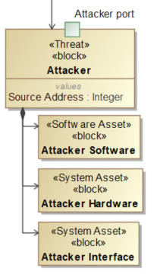
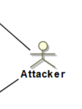
Recommendations
To enhance the applicability of the MBSEsec method to the compromised system, we added an attacker element to the network structure
Facilitates the incorporation of zero trust principles as specified by NIST 800-207, and Executive Order 14028 "Improving the Nation's Cybersecurity"
Enabled the further elaboration of the behavior diagrams and misuse cases.
Improved brainstorming about the attacker's impact on the network
Effective use of MBSEsec requires a prior threat and risk analysis to identify vulnerabilities
Otherwise, MBSEsec is the first iteration of analyzing threats and risks
In the case of this work, the threats and risks were already known
Research Question #1
32
Notes:
Two recommendations:
1) As mentioned earlier, we added an attacker element to the model due to the compromised state of the protocol
We recommend to add this element to the model to enable further elaboration of behavior and misuse cases. By implementing this element, the model must be designed around it.
This incorporates the principle of zero trust, which is where the cyber security field is headed.
2) If the system does not have preexisting vulnerabilities, (i.e. New system), it is recommended to conduct a top level risk assessment before beginning the modeling process.
This will allow for the modeling process to be more solution oriented.

Slide 33
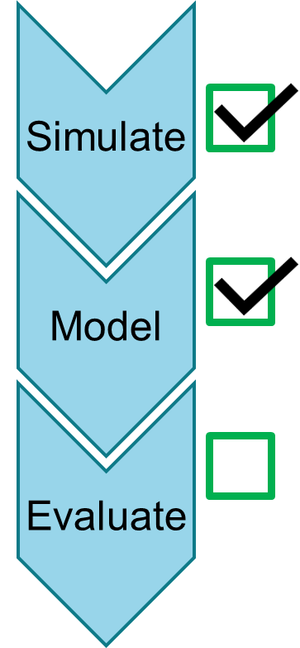
Research Question 1 Discussion
MBSEsec offers a valuable method for secure system development
This method facilitated an effective environment for security control development
The outputs of MBSEsec phases were continuously reviewed and updated after each phase – made for a more fluid design experience and easy brainstorming
Using MBSEsec enabled:
Depth of knowledge of the system grew as the model was built
Easy solution driven brainstorming for security controls
Iterative improvement of security requirements and controls
Ease of traceability as the model grew in complexity
MBSEsec provides substantial benefits to security control development
Research Question #1
33

Slide 34
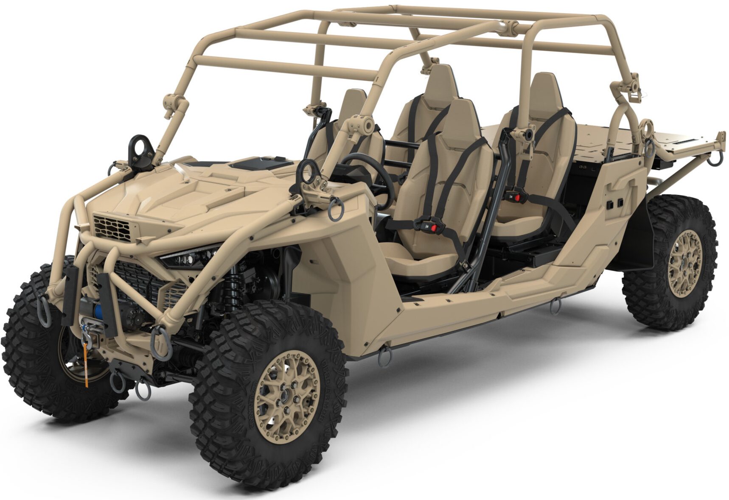
Application and Evaluation of MBSEsec to Polaris MRZR off-road vehicle.
To further examine the utility of MBSEsec, the method was applied to a second vehicular system with similar network configurations and properties
Questions: Can MBSEsec…
Help make better design decisions with lower security SME level
Prove its value in being a repeatable and iterative approach for documenting the system
Enable better requirements and security control development
MRZR Details:
All-terrain vehicle designed for military use
System of Interest: Remote control system applied on top of a standard off-road vehicle
The design team had already conducted a cybersecurity table-top, including:
a. Risk analysis
b. Details of the primary vulnerabilities of the system
Research Question #1
34

Slide 35
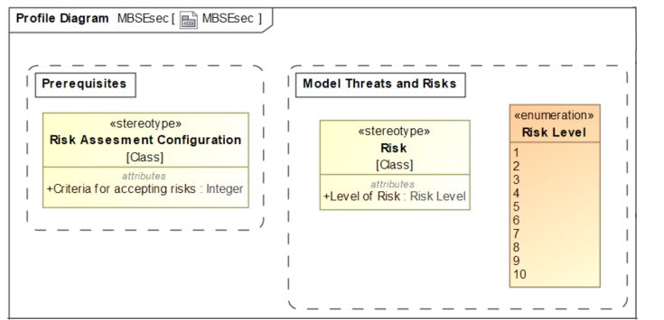
Discovered Shortcomings
Lacking a sufficient level of quantitative detail when addressing risk
How do you ensure that risks are mitigated and that they do not exceed an established threshold?
How do you incorporate the Criteria for Accepting Risk into decision making process?
How do you classify levels of risk for each vulnerability? On what scale?
For the structural risk definition, we recommend the new Threat and Risk Definition diagram, which should be based on the UML Class diagram. In this diagram, the following elements should be created and linked: Risk; Risk Treatment; Risk Impact; Threat; and Vulnerability. Alternatively, a HAZOP style table can be used to summarize risk-related information.
Research Question #1
35

Slide 36
Recommended Changes
Recommended changes will be demonstrated on the Polaris MRZR off-road vehicle
Research Question #1
36

Slide 37
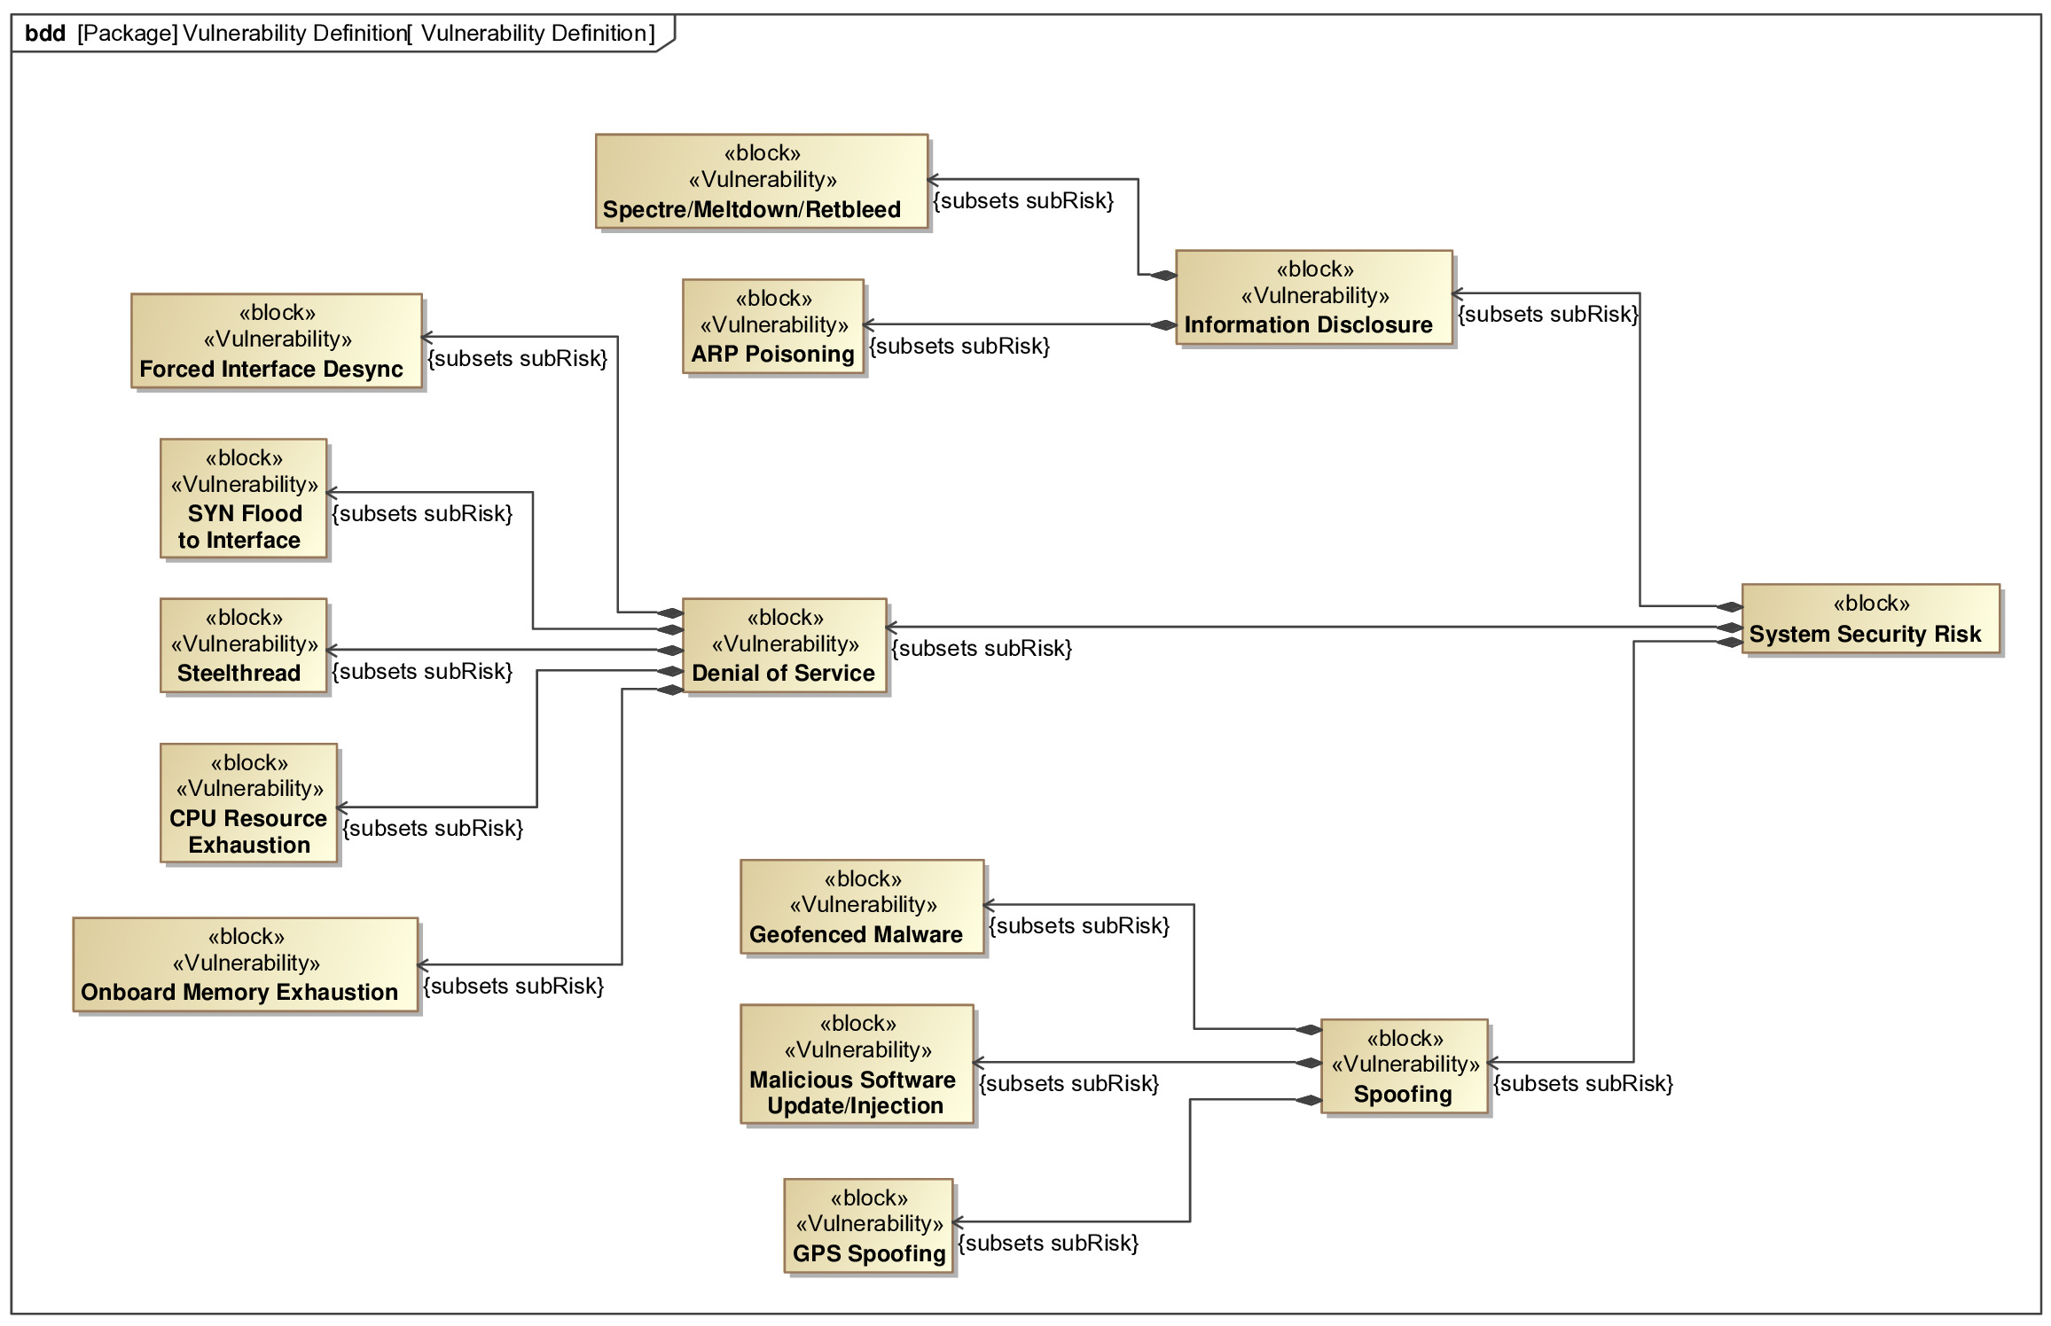
Vulnerability Definition Diagram
Defines all the relevant vulnerabilities that threaten the system
Follows the structure of an attack tree
Starting from a central objective and branching into sub-goals and specific attack techniques
STRIDE used to categorize threats to the system (each branch represents 1/5 categories)
Parent block is titled “System Security Risk”
STRIDE: Spoofing, Tampering, Repudiation, Information Disclosure, Denial of Service, and Elevation of Privilege
Research Question #1
37

Slide 38
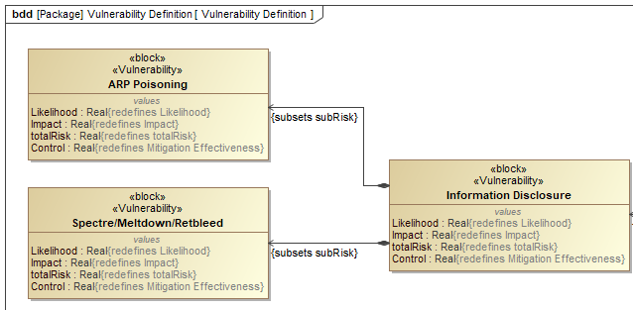
Characterizing Risk
To characterize the risk associated with each vulnerability:
Each block is elaborated with its respective Impact and Likelihood using value properties
Each vulnerability is assigned a value property for its likelihood
and impact on a scale of 1 to 5 [32]
Research Question #1
38

Slide 39
Risk roll-up Pattern
A roll-up pattern enables aggregation relationships through assigning property values, and rolling up information from lower-level components to higher-level blocks using parametrics
Total Risk
Research Question #1
39

Slide 40
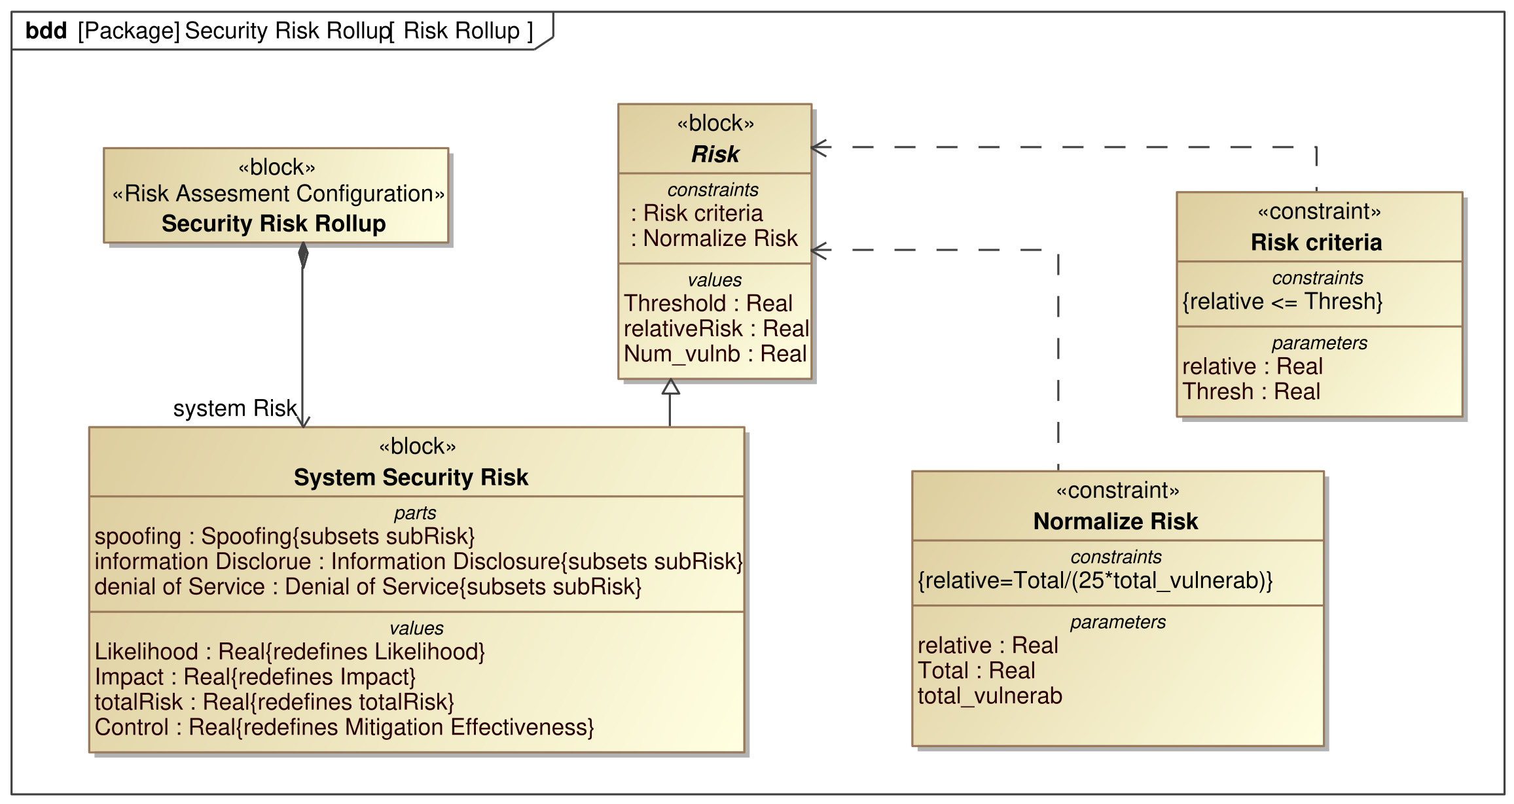
Risk Assessment Diagram
The Security Risk Rollup block is attributed two constraints; Risk Criteria and Normalize Risk.
These two constraints are the means by which the system risk posture is evaluated
Relative risk: outputs a value between 0 and 1, which specifies the severity of the risk posture:
0 means no risk from the vulnerabilities,
1 means every vulnerability is likely to occur with high severity
Total Risk
Tests whether the system risk is below the selected threshold
Research Question #1
40

Slide 41
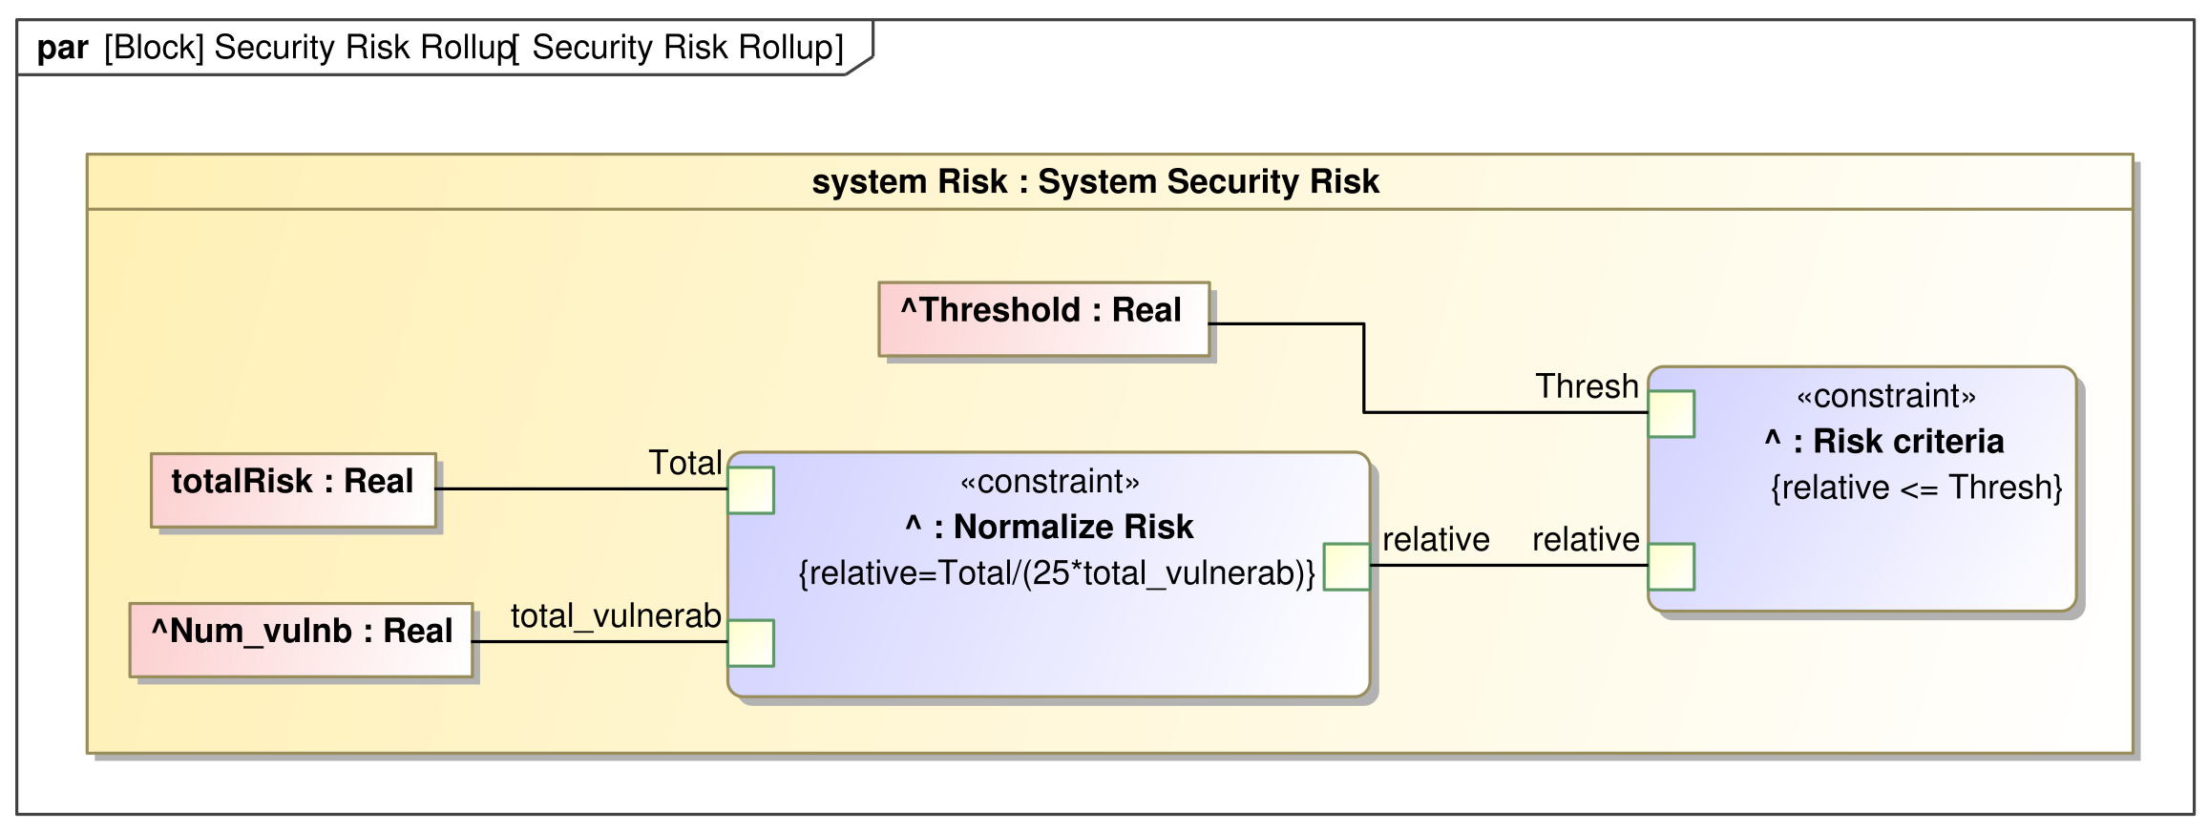
In the background…
Parametric diagram performing the operations
Research Question #1
41

Slide 42
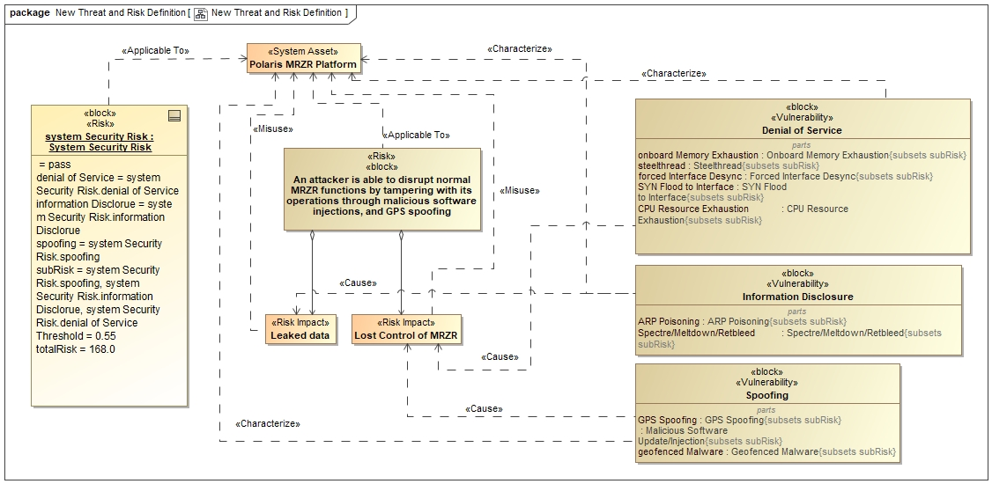
Updated Threat and Risk Definition Diagram
Research Question #1
42

Slide 43
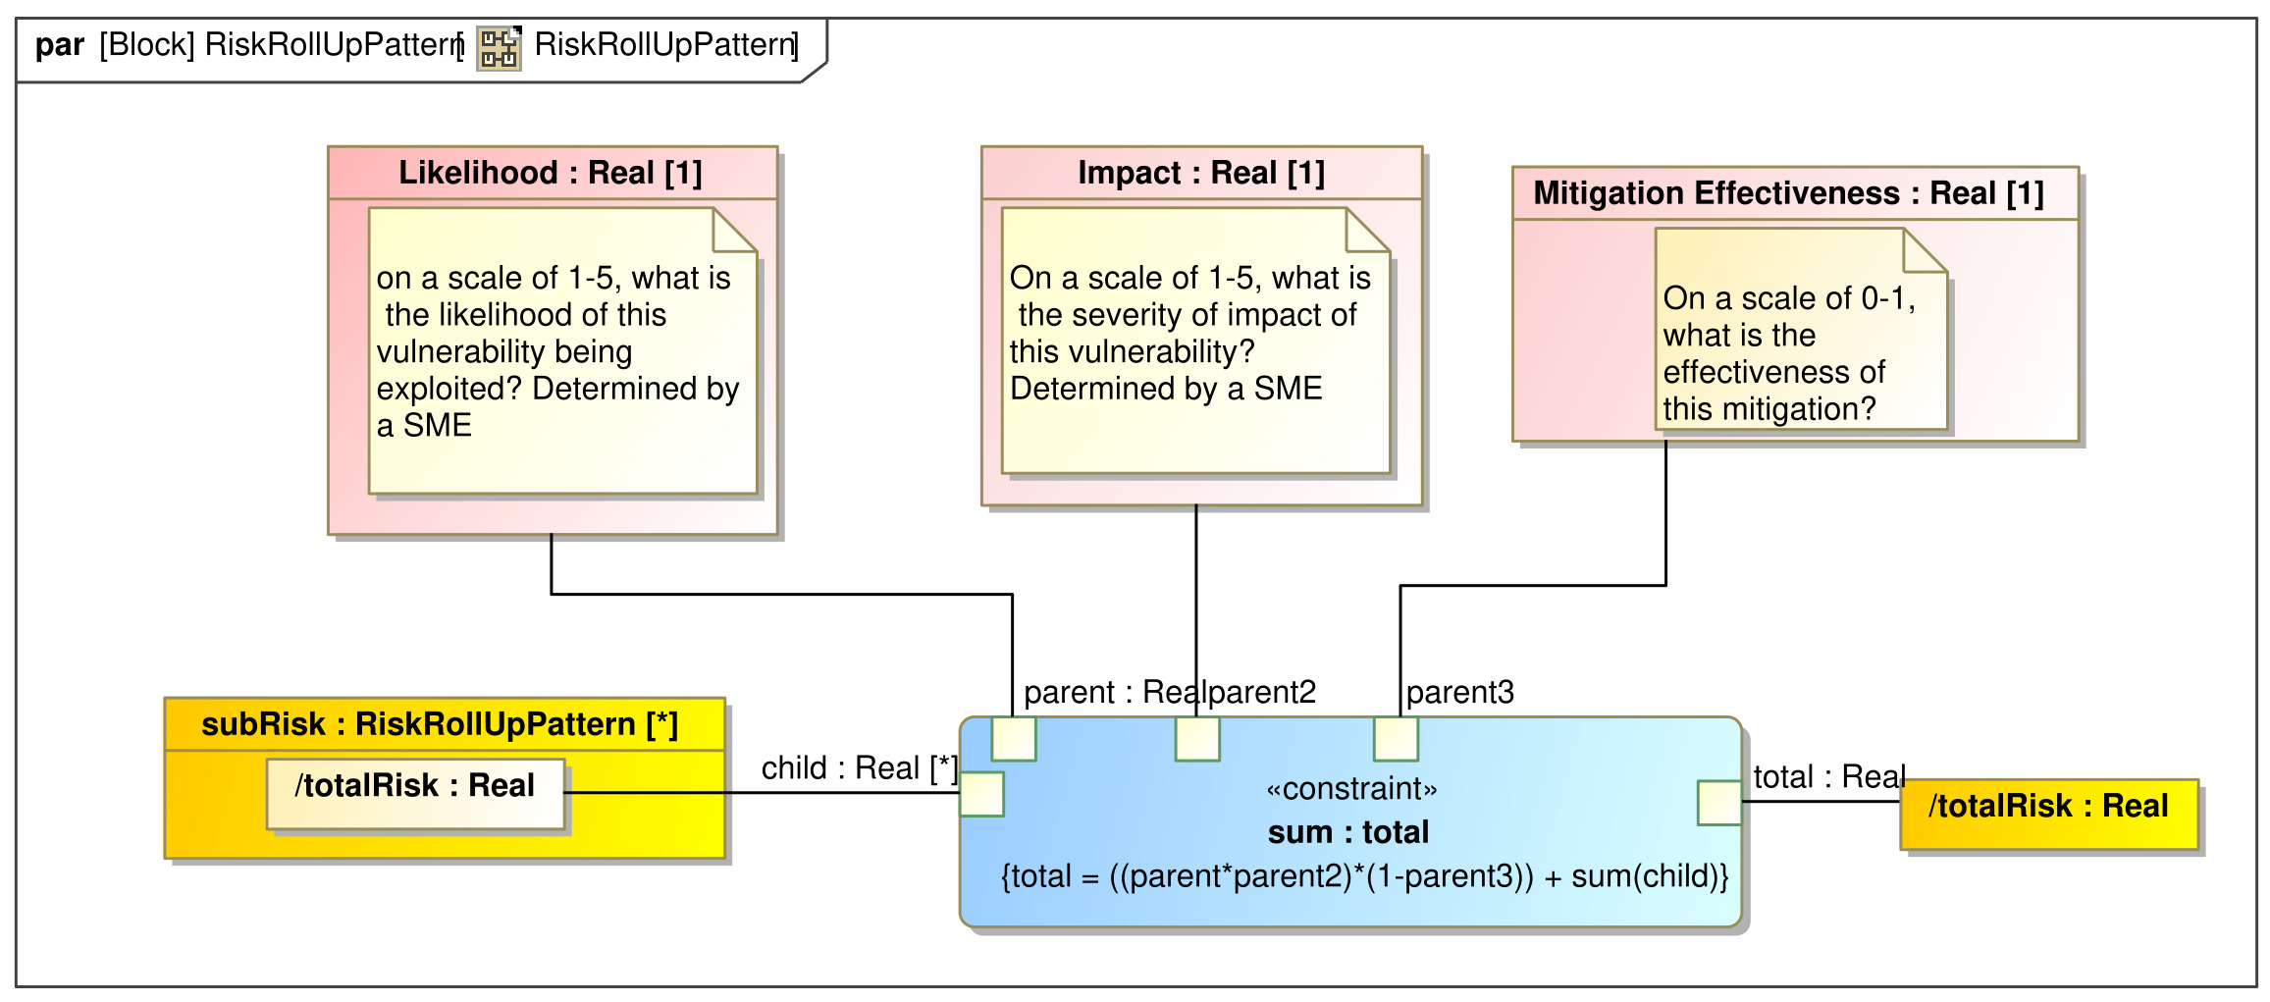
Integrating Security controls
As the controls are articulated, each vulnerability is assigned a Mitigation Effectiveness Value in percentile form
A ‘control’ value property was added to the risk roll-up pattern for each vulnerability
A new overall risk is calculated the system
Research Question #1
43

Slide 44
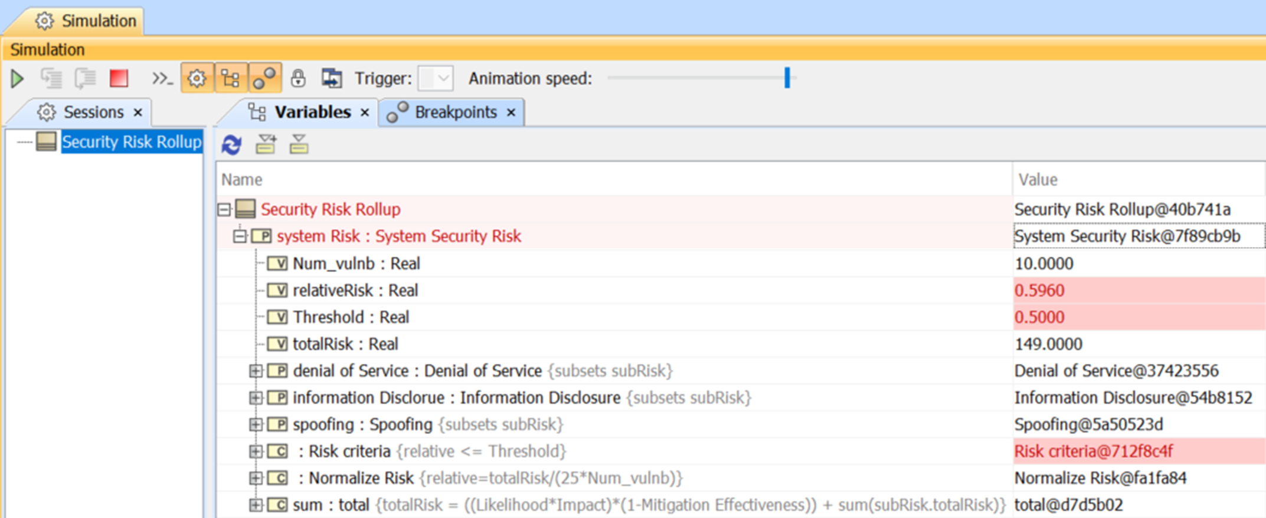
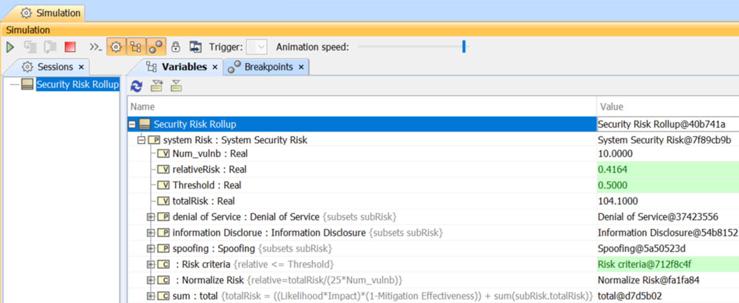
Simulating the model
Model without controls
Vulnerabilities are defined, and values of likelihood and impact are defined for each vulnerability
A risk threshold is defined
The model outputs the following values:
Overall Risk
Normalized risk
Pass/Fail on threshold
Control effectiveness is implemented for each vulnerability
Final model output: Pass/Fail
Model with controls
Research Question #1
44

Slide 45
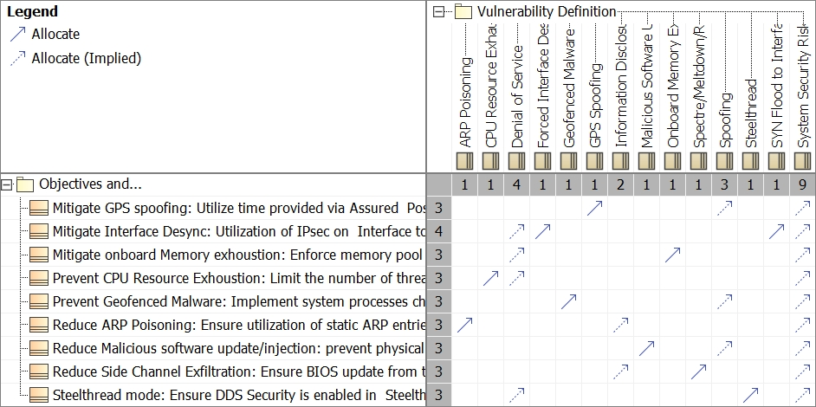
Traceability: Security Controls to Vulnerabilities
Allocation of each vulnerability to their associated security controls
Each vulnerability has at least one security control to mitigate its effects
Security controls to system vulnerability
Research Question #1
45

Slide 46
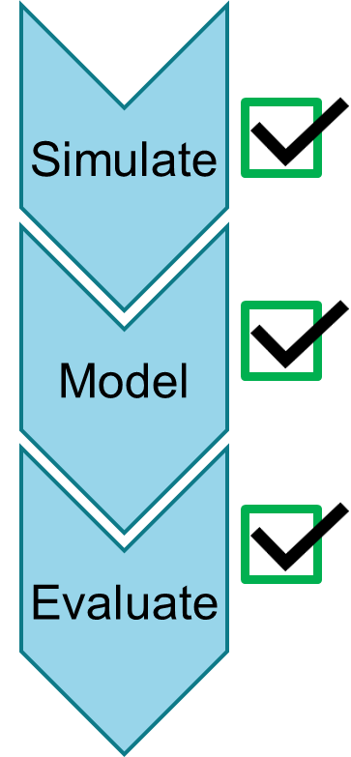
Research Question 1 Conclusion
Problem: Shortcomings found in the Modeling Threats and Risks phase
Solution: Implemented - STRIDE classification, quantitative risk definition, risk roll-up, risk threshold, control effectiveness, simulation
Benefits:
Improved documentation of risk analysis
Improved understanding of system’s risk posture: better decision making
Demonstrated benefits of simulation for risk evaluation
Enhanced traceability between vulnerabilities and security controls
NIST SP 800-53r5 [14]: "The combination of a catalog of security and privacy controls and a risk-based control selection process can help organizations comply with stated security and privacy requirements”
Improved compliance with the NIST SP 800-53 Standard
Research Question #1
46
Notes:
MBSE methodologies promise to ease systems engineers' challenges in communication across different engineering disciplines
Especially in terms of completeness and consistency
Effectively document the process to determining appropriate security controls

Slide 47
Research Question 2:
How can MBSE be leveraged to conduct security requirement elicitation in the design of secure systems?
Motivation: “The system shall be secure” is not an adequate security requirement. Specified security requirements often become security-specific architectural constrains [Firesmith, Engineering secure requirements].
Research Tasks:
3.1 Investigate literature, frameworks, and methods related to security requirement elicitation
3.2 Support the development of a Security Focused Goal Elicitation Method using MBSE (EGRESS)
a. Develop an MBSE model that implements the proposed method
3.3 Demonstrate the benefits of the outputs of this method to the rest of the design process
Output: A proposed approach to elicit security goals for systems in conceptual design using MBSE
47

Slide 48
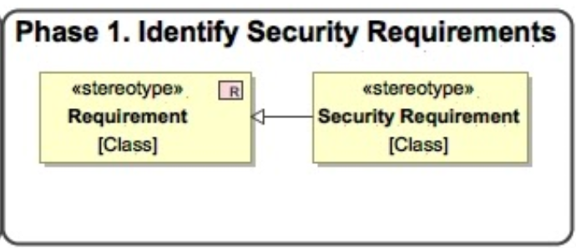
Security Requirements Process – MBSEsec
MBSEsec: Model-Based Systems Engineering Method for Creating Secure Systems
Mažeika and Butleris (2020) [26]
How Do We Get These Initial Requirements?
Phase 1—Identify Security Requirements. The starting point of the MBSEsec method is to identify the security requirements as an additional part of the functional and non-functional requirements that are usually captured at an early stage of SE model creation.
The first phase of “Identify Security Requirements” suggests that the security requirements should be identified, captured, and refined in the MBSE model. Ideally, engineers who are working in the security requirements engineering discipline should combine expertise in security, domain, and requirements engineering fields to provide a foundation for developing a secure system [26].
Research Question #2
48

Slide 49
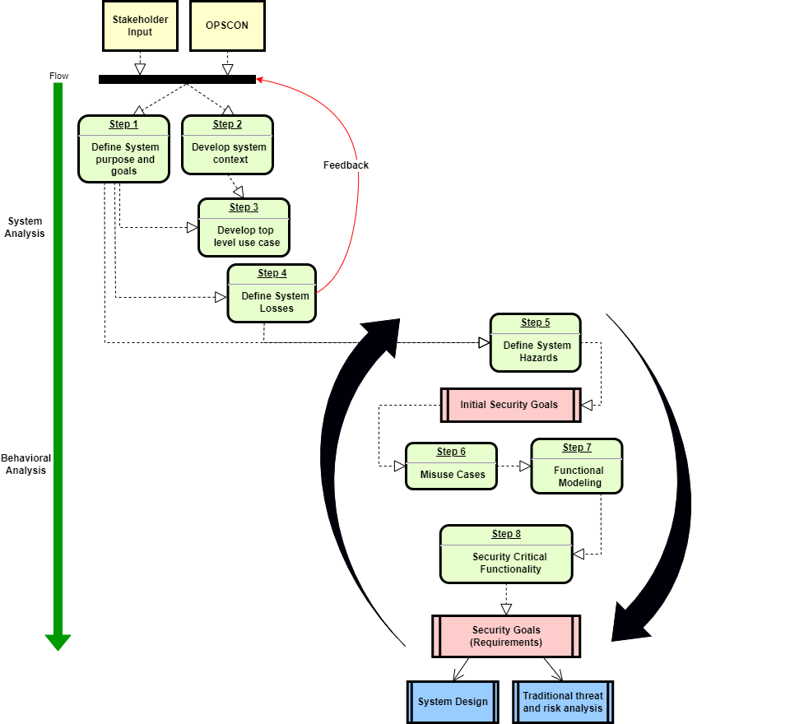
Eliciting Goals for Requirements Engineering of Secure Systems
EGRESS
Research Question #2
49

Slide 50
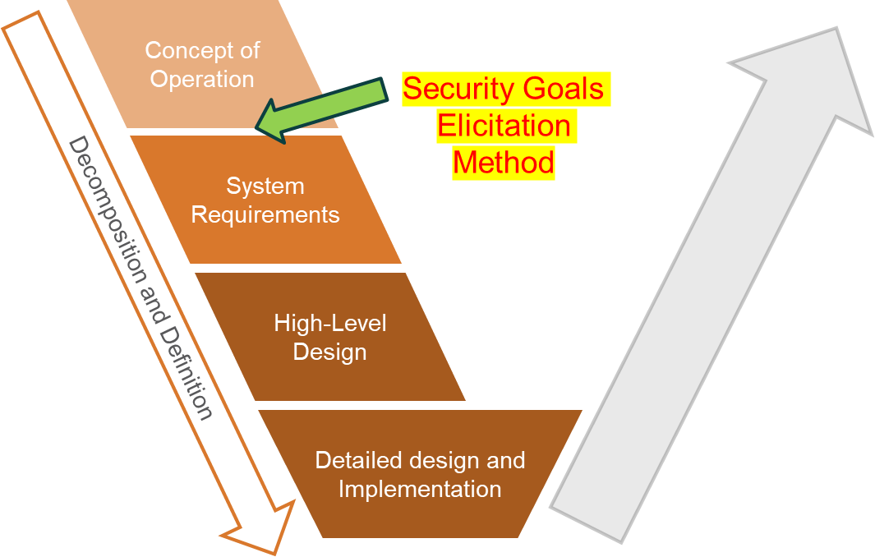
EGRESS Place within the System-V Framework
System of Interest for demonstration: Polaris MRZR
Research Question #2
50

Slide 51
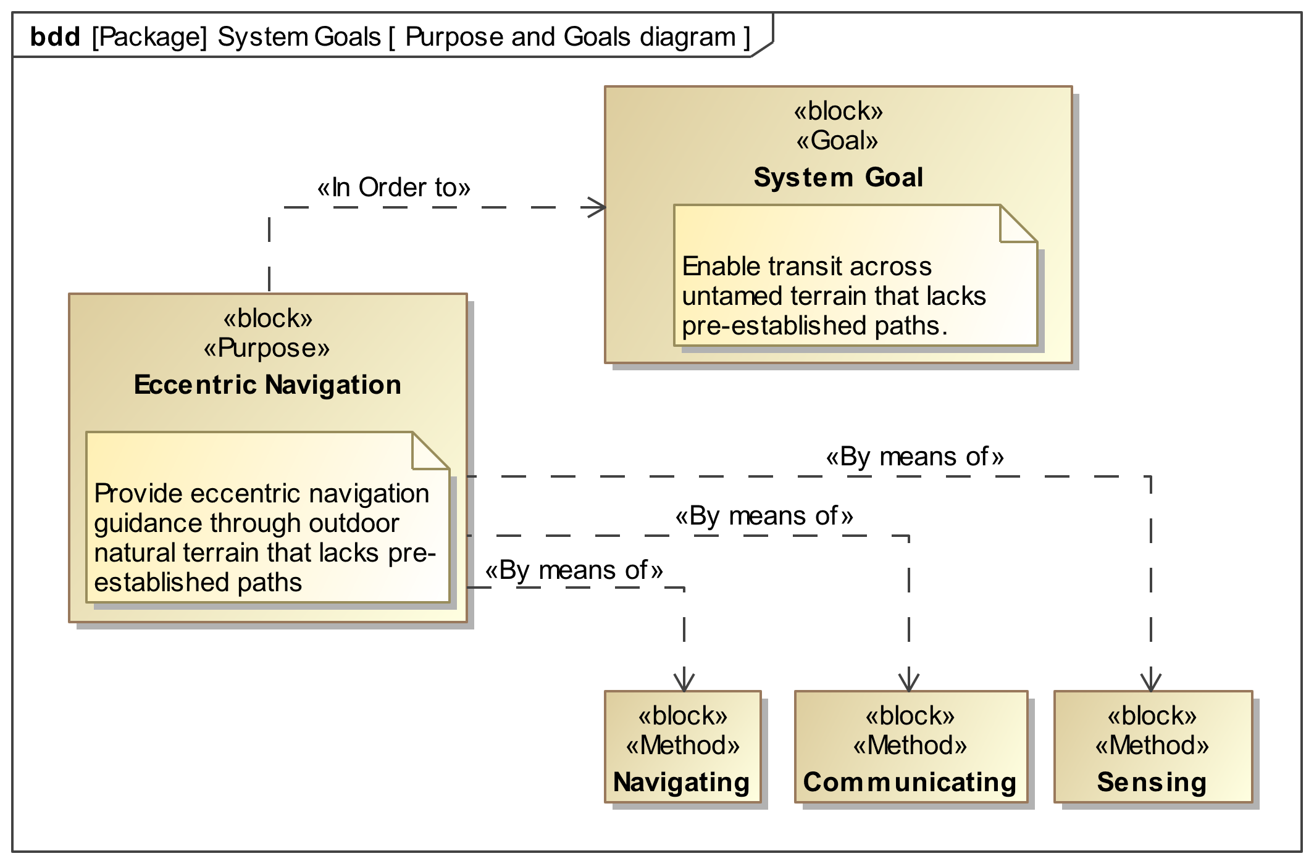
Step 1: System Purpose and Goals Diagram
Guide the rest of the modeling process
High level of abstraction
Ensure stakeholder agreement
Uses a block definition diagram
Custom Stereotypes: Goal, Purpose, and Method
Custom dependency: In order to… and By means of…
Research Question #2
51

Slide 52
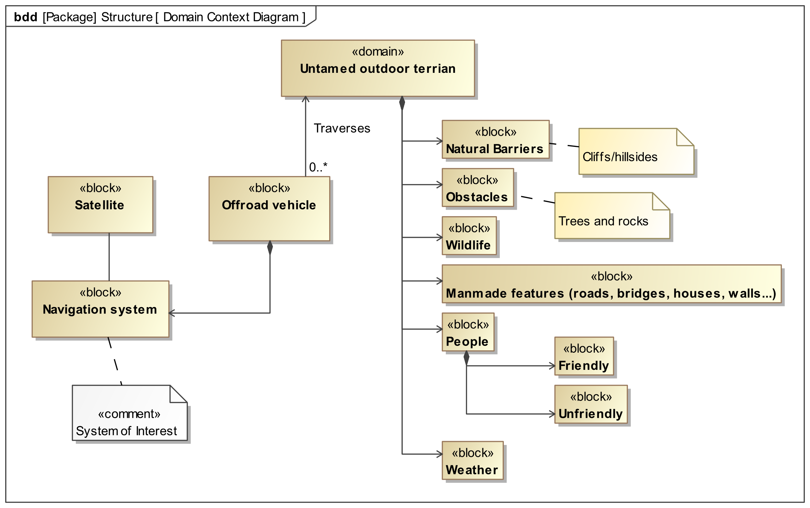
Step 2: System Context Diagram
Capture the context in which the system will operate: What is ’in bounds’ for the system design?
Considered ’complete’ when all relevant elements external to the system have been identified
Uses a block definition diagram
Ensures stakeholder agreement
Research Question #2
52

Slide 53
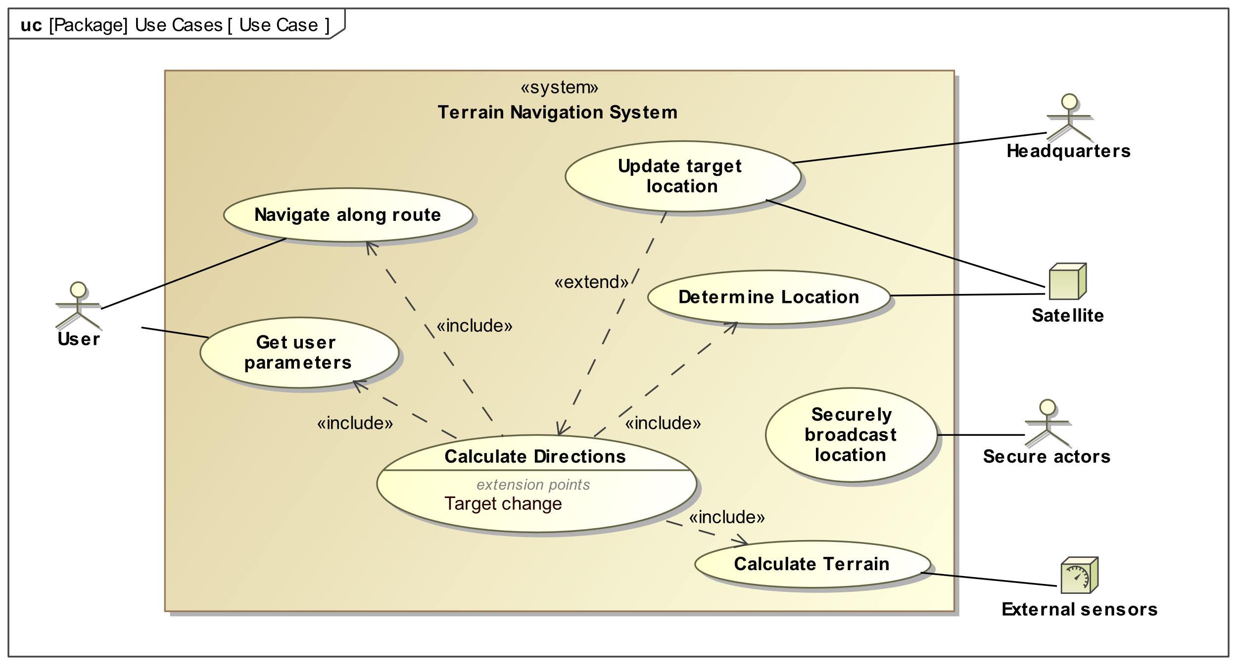
Step 3: Use Case Diagram
Depict the system’s objectives from the perspective of it users
Defined in terms of the functions the system needs to support
Identifies key actors
Outlines high-level behavioral goals that the system must fulfill
Facilitates further stakeholder agreement
Research Question #2
53

Slide 54
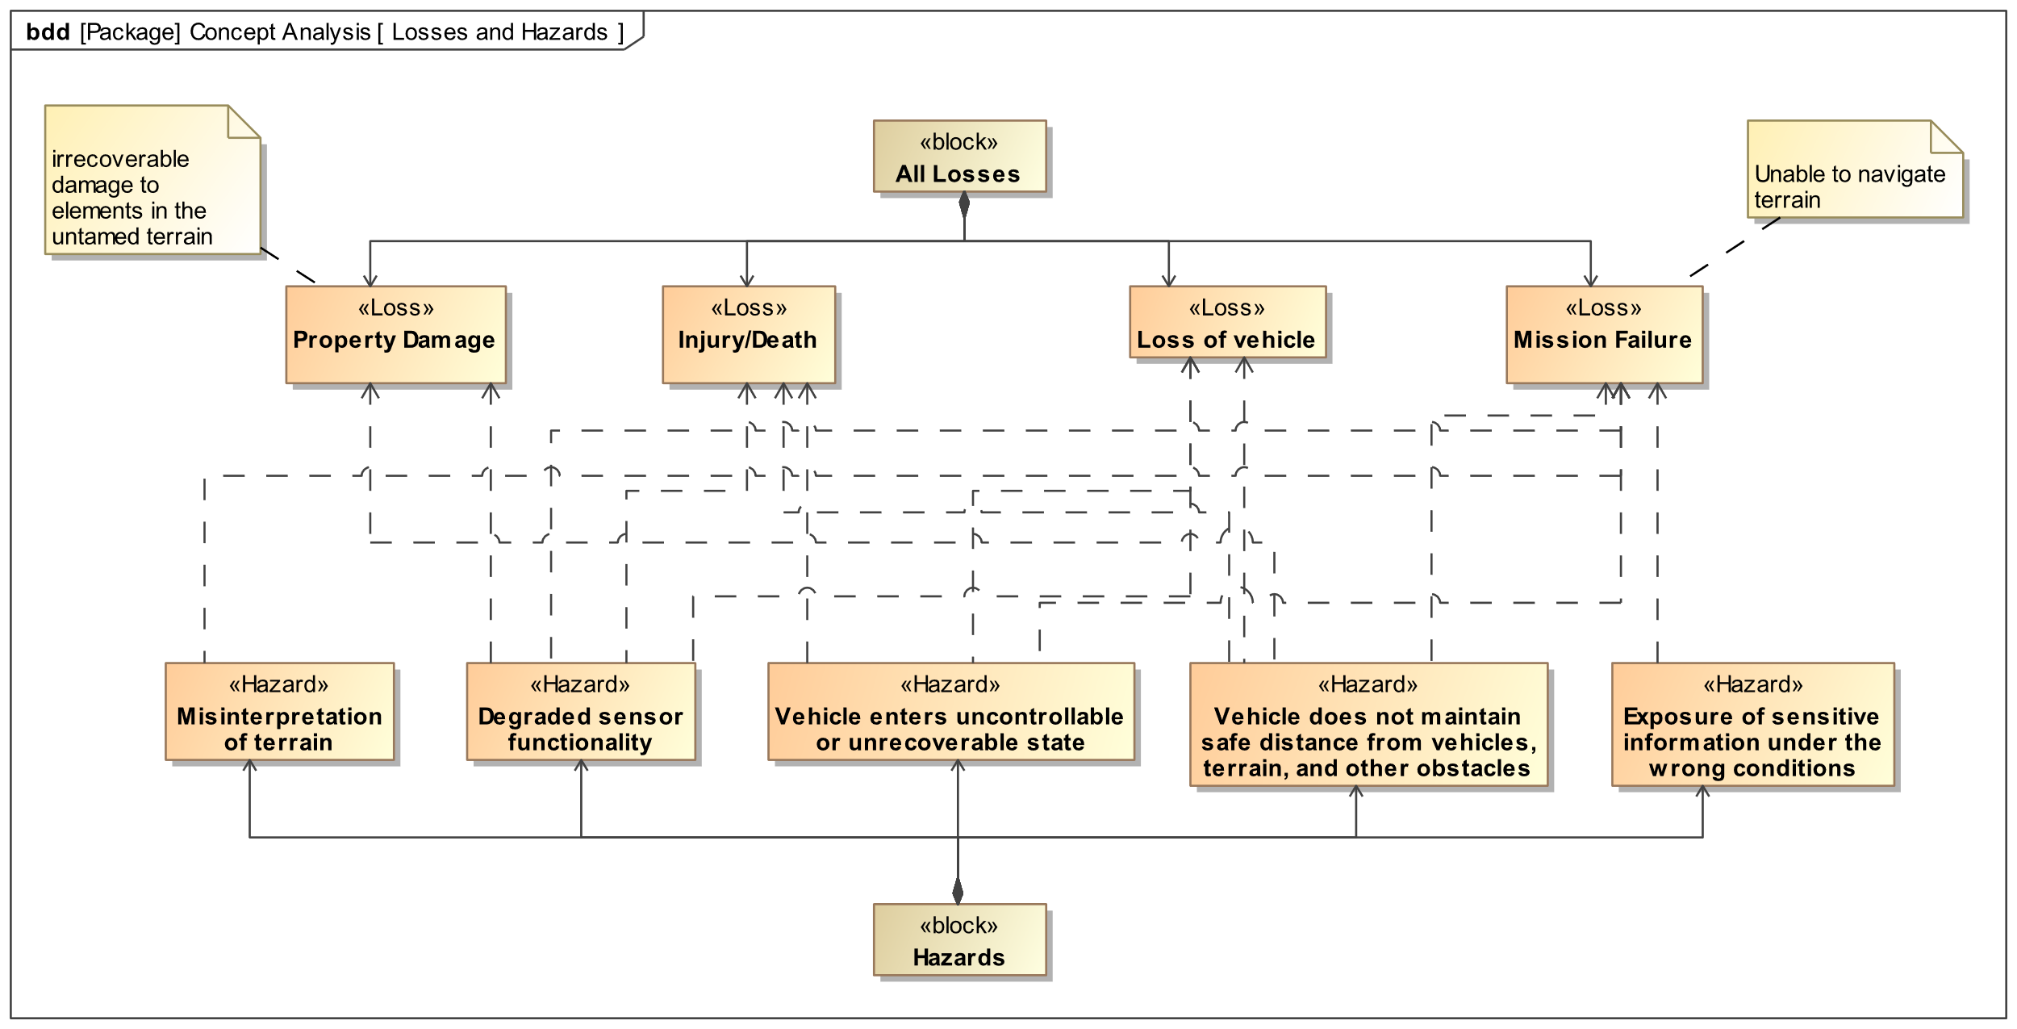
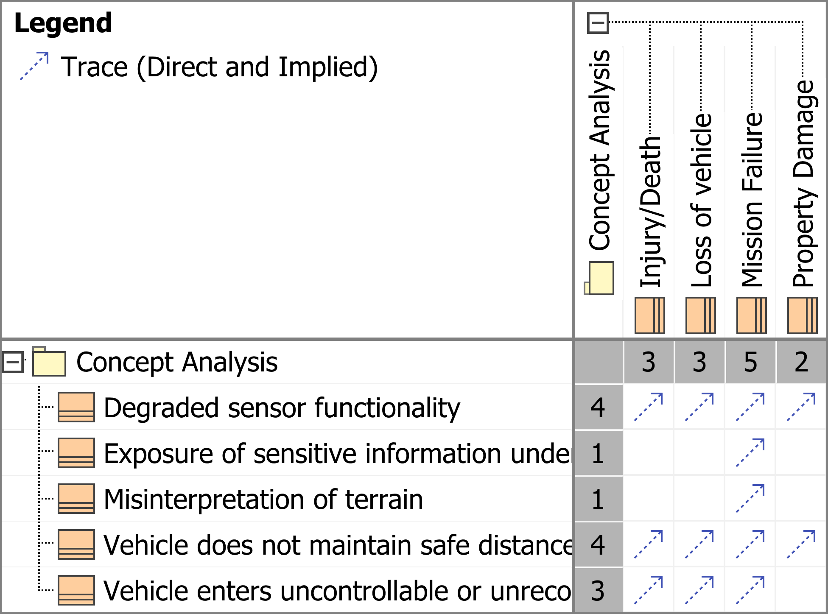
Steps 4 & 5 : System Unacceptable Losses and Hazards
1. What can the user not afford to lose in the system operation?​
2. What system states (when paired with worst case environmental conditions) can lead to an unacceptable loss?
Two new stereotypes: Loss and Hazard
Enable simple and easy traceability throughout in the model
Losses to Hazards mapping
Research Question #2
54

Slide 55
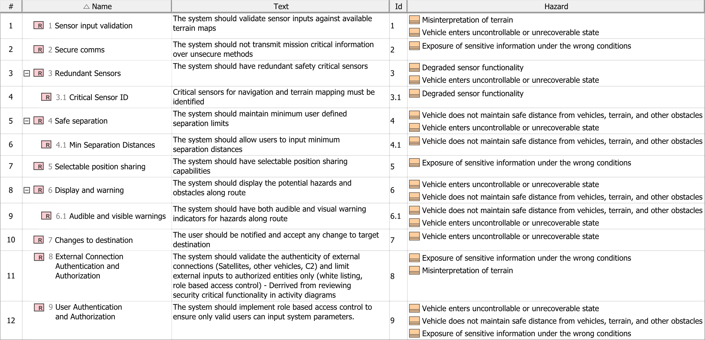
Initial Security Goals
Based on ensuring that the system does not enter the hazardous states identified in Step 5
Defined using a requirement table
Hazards are allocated to system goals with a custom ‘prevents’ relationship
Research Question #2
55

Slide 56
Step 6: Misuse Cases
Add an attacker/malicious actor to the diagram
Determine how each use case might be susceptible to:
Confidentiality: Secure information access
Integrity: Ensure data accuracy & reliability.
Availability: Maintain data accessibility
New stereotypes for CIA used to classify use cases
New dependency: Exploits…
Research Question #2
56

Slide 57
Steps 7 & 8: Functional Modeling & Security Critical Functions
Elaborate each use case with an activity diagram
Describe key behaviors of the system
Important activities are identified as security critical functions
New stereotype: Security Critical Function
Also used: Confidentiality, Integrity, Availability stereotypes
Research Question #2
57

Slide 58
Steps 7 & 8: Functional Modeling & Security Critical Functions
New Goal Added
Research Question #2
58

Slide 59
Verification and Satisfaction Checks
Security critical functions to security goals​
Goal to Hazard allocation
Benefit to MBSE: Traceability!
Research Question #2
59

Slide 60
System Security Goals
These goals are NOT intended to replace fully specified system requirements for security, instead they are used to get stakeholder alignment in considering security as a fundamental system attribute, like performance.​
The are used to guide system requirements definition and the preliminary architecture development decisions with respect to security.
Research Question #2
60

Slide 61
Research Overview
Introduction and Motivation
Literature Overview
Research Questions
Contributions

Slide 62
Research Contributions
Research Question 1:
Analysis of the utility of model simulation by replicating attacks on truck networks in MBSE
Application and analysis of MBSEsec applied to the J1939 network protocol
- Suggested a method that would make the ECU input parser more robust
Recommended improvements of the MBSEsec method through the application to the MRZR
Research Question 2:
Development of a method to generate system goals using MBSE with a focus on security for system conceptual design
Salinger, G., Span, T., Daily, J. "A Demonstration of MBSEsec Applied to Securing Cyber Physical System Communications," to appear at the IEEE Aerospace Conference, 4 March 2024, Big Sky, MT.
Research Question #2
62
Notes:
Provided a technique for adding clarity input parser, and reducing undefined states in the protocol

Slide 63
Real Conclusion
https://www.istockphoto.com/photo/old-truck-gm1246457867-363196658
Research Question #2
63

Slide 64
Questions?

Slide 65
References
[1] R. Chatterjee, S. Mukherjee, and J. Daily, “Exploiting Transport Protocol Vulnerabilities in SAE J1939 Networks,” in Proceedings Inaugural International Symposium on Vehicle Security & Privacy. San Diego, CA, USA: Internet Society, 2023. [Online]. Available: https://www.ndss-symposium.org/wpcontent/uploads/2023/02/vehiclesec2023-23053-paper.pdf
[2] M. T. Campo, S. Mukherjee, and J. Daily, “Real-Time Network Defense of SAE J1939 Address Claim Attacks,” SAE International Journal of Commercial Vehicles, vol. 14, no. 3, pp. 02–14–03–0026, Aug. 2021. [Online]. Available: https://www.sae.org/content/02-14-03-0026/4
[3] Department of Defense. Digital Engineering Strategy, 2018.
[4] Systems Engineering Vision 2035: https://www.incose.org/2023_redesign/publications/se-vision-2035
[5] Ron Ross, Mark Winstead, and Michael McEvilley. Engineering Trustworthy Secure Systems. Technical Report NIST Special Publication (SP) 800-160 Vol. 1 Rev. 1, National Institute of Standards and Technology, November 2022
[6] Christopher Delp, Doris Lam, Elyse Fosse, and Cin-Young Lee. Model based document and report generation for systems engineering. In 2013 IEEE Aerospace Conference, pages 1–11, March 2013. ISSN: 1095-323X.
[7] Lenny Delligatti. SysML Distilled: A Brief Guide to the Systems Modeling Language. Addison-Wesley Professional, 2013.

Slide 66
References
[8] Jan Jürjens. UMLsec: Extending UML for Secure Systems Development. In Gerhard Goos, Juris Hartmanis, Jan van Leeuwen, Jean-Marc Jézéquel, Heinrich Hussmann, and Stephen Cook, editors, UML 2002 — The Unified Modeling Language, volume 2460, pages 412–425. Springer Berlin Heidelberg, Berlin, Heidelberg, 2002. Series Title: Lecture Notes in Computer Science.
[9] SO/IEC/IEEE 15288:2015 Systems and software engineering — System life cycle processes, May 2015.
[10] dilson Soares Palma, Elisa Yumi Nakagawa, Débora Maria Barroso Paiva, and Maria Istela Cagnin. Evolving reference architecture description: Guidelines based on iso/iec/ieee 42010, 2022
[11] David D. Walden, Garry J. Roedler, Kevin J. Forsberg, R. Douglas Hamelin, and Thomas M. Shortell. INCOSE Systems Engineering Handbook: A Guide for System Life Cycle Processes and Activities. John Wiley & Sons, Inc, 4 edition, July 2015.
[12] SO/SAE 21434: Road Vehicles - Cybersecurity Engineering - SAE International
[13] Ron Ross, Mark Winstead, and Michael McEvilley. Engineering Trustworthy Secure Systems. Technical Report NIST Special Publication (SP) 800-160 Vol. 1 Rev. 1, National Institute of Standards and Technology, November 2022

Slide 67
References
[14] Joint Task Force Interagency Working Group. Security and Privacy Controls for Information Systems and Organizations. Technical report, National Institute of Standards and Technology, September 2020. Edition: Revision 5
[15] Meenakshi Deshmukh. Security requirements engineering process. In Seminar in Information System, Security Engineering. Citeseer, 2009
[16] Shafiq ur Rehman, Christopher Allgaier, and Volker Gruhn. Security Requirements Engineering: A Framework for Cyber-Physical Systems. In 2018 International Conference on Frontiers of Information Technology (FIT), pages 315–320, December 2018. ISSN: 2334-3141
[17] Adam Shostack. Threat Modeling: Designing for Security. John Wiley & Sons, Hoboken, New Jersey, 2014
[18] Benjamin Fabian, Seda Gürses, Maritta Heisel, Thomas Santen, and Holger Schmidt. A comparison of security requirements engineering methods. Requirements Engineering, 15(1):7–40, March 2010.
[19] Donald Firesmith. Engineering Security Requirements. The Journal of Object Technology,2(1):53, 2003
[20] C.B. Haley, R. Laney, J.D. Moffett, and B. Nuseibeh. Security Requirements Engineering: A Framework for Representation and Analysis. IEEE Transactions on Software Engineering,34(1):133–153, January 2008

Slide 68
References
[21] D. Mažeika and R. Butleris. Integrating Security Requirements Engineering into MBSE: Profile and Guidelines. Security and Communication Networks, 2020:1–12, March 2020.
[22] Michael Brunner, Michael Huber, Clemens Sauerwein, and Ruth Breu. Towards an Integrated Model for Safety and Security Requirements of Cyber-Physical Systems. In 2017 IEEE International Conference on Software Quality, Reliability and Security Companion (QRS-C), pages 334–340, Prague, Czech Republic, July 2017. IEEE.
[23] Donatas Mazeika and Rimantas Butleris. Identifying Security Issues with MBSE while Re- building Legacy Software Systems. In 2020 IEEE 15th International Conference of System of Systems Engineering (SoSE), pages 83–86, June 2020
[24] Yves Roudier and Ludovic Apvrille. SysML-Sec: A model driven approach for designing safe and secure systems. In 2015 3rd International Conference on Model-Driven Engineering and Software Development (MODELSWARD), pages 655–664, February 2015.
[25] Christian Raspotnig, Vikash Katta, Peter Karpati, and Andreas L. Opdahl. Enhancing CHASSIS: A Method for Combining Safety and Security. In 2013 International Conference on Availability, Reliability and Security, pages 766–773, September 2013.
[26] Donatas Mažeika and Rimantas Butleris. MBSEsec: Model-Based Systems Engineering Method for Creating Secure Systems. Applied Sciences, 10(7):2574, April 2020

Slide 69
References
[27] Jin Seo Park, Daehyun Kim, Seokmin Hong, Hyunjung Lee, and EuiJung Myeong. Case Study for Defining Security Goals and Requirements for Automotive Security Parts Using Threat Modeling. pages 2018–01–0014, April 2018
[28] Ahmad Y. Javaid, Weiqing Sun, Vijay K. Devabhaktuni, and Mansoor Alam. Cyber security threat analysis and modeling of an unmanned aerial vehicle system. In 2012 IEEE Conference on Technologies for Homeland Security (HST), pages 585–590, Waltham, MA, USA, November 2012. IEEE
[29] Dmytro Klets, Igor V. Gritsuk, Andrii Makovetskyi, Nickolay Bulgakov, Mikhail PodrigaloIhor Kyrychenko, Olena Volska, and Nikolai Kyzminec. Information Security Risk Management of Vehicles. pages 2018–01–0015, April 2018.
[30] Rik Chatterjee, Subhojeet Mukherjee, and Jeremy Daily. Exploiting Transport Protocol Vulnerabilities in SAE J1939 Networks. In Proceedings Inaugural International Symposium on Vehicle Security & Privacy, San Diego, CA, USA, 2023. Internet Society.
[31] Bernard Zeigler, Saurabh Mittal, and Mamadou Traore. MBSE with/out Simulation: State of the Art and Way Forward. Systems, 6(4):40, November 2018
[32] Mason Michael Woodruff. Consequence and likelihood in risk estimation: A matter of balance in UK health and safety risk assessment practice. Safety Science, 43(5-6):345–353, June 2005.
Research Question #2
69

Slide 70
Key Systems Engineering Standards
ISO/IEC/IEEE 42010 [9] - Software Architecture Description
Highlights security architecture by design, need for early stakeholder involvement – traceability!
ISO/IEC/IEEE 15288 [10] - System Life Cycle Processes
Emphasizes the systematic and structured nature of systems engineering - need for MBSE (traceable model)
INCOSE Systems Engineering Handbook [11]
INCOSE Technical Processes
Stakeholder security Interest -> Security requirements -> Minimize security risk
MBSE improves:
Communications, ability to manage complexity, knowledge capture
Improves system requirements, architecture, and design quality
Literature Overview
Notes:
ISO/IEC/IEEE 15288 is a systems engineering standard developed by the consensus of SE experts from government, industry, and academia. It is recognized by both industry and the Department of Defense (DoD) as being a common process framework for the performance of effective systems engineering throughout the system life cycle.

Slide 71
Key Systems Engineering Standards
Alignment of ISO/IEC 15288 and SE Handbook
ISO/IEC 15288:2008 System Life Cycle Process | INCOSE SE Handbook v4e Section 4.0
6.4 Technical Processes | 4.0 Technical Processes
6.4.1 Business or Mission Analysis | 4.1 Business or Mission Analysis
6.4.2 Stakeholder Needs and Requirements Definition | 4.2 Stakeholder Needs and Requirements Definition
6.4.3 Systems Requirements Definition | 4.3 Systems Requirements Definition
6.4.4 Architectural Definition | 4.4 Architectural Definition
6.4.5 Design Definition | 4.5 Design Definition
6.4.6 System Analysis | 4.6 System Analysis
6.4.7 Implementation | 4.7 Implementation
6.4.8 Integration | 4.8 Integration
6.4.9 Verification | 4.9 Verification
6.4.10 Transition | 4.10 Transition
6.4.11 Validation | 4.11 Validation
6.4.12 Operation | 4.12 Operation
6.4.13 Maintenance | 4.13 Maintenance
6.4.14 Disposal | 4.14 Disposal
How should Security be addressed in these early Processes?
Within the handbook (Chapter 4), security is only lightly addressed, and always grouped with other factors such as “health, safety, security, environment, assurance, adaptability and resilience”
Literature Overview
Notes:
ISO/IEC/IEEE 15288 is a systems engineering standard developed by the consensus of SE experts from government, industry, and academia. It is recognized by both industry and the Department of Defense (DoD) as being a common process framework for the performance of effective systems engineering throughout the system life cycle.

Slide 72
INCOSE MBSE
Model Based Systems Engineering (Ch 9.2)
The system model is a primary artifact of the SE process. Used to capture each technical process
MBSE for­malizes the application of SE through the use of models.
Literature Overview

Slide 73
System Security Guiding Standards
ISO 21434 [12] - Cybersecurity Engineering for Road Vehicles (replaced J3061)
Introduces TARA (Threat Analysis and Risk Assessment), helps with developing security requirements and controls
NIST 800-160v1 [13] - Engineering Trustworthy Secure Systems
Deliver system capabilities at an acceptable level of performance while minimizing (preemptive and reactive measures) the occurrence and extent of loss
NIST 800-53 r5 [14] - Security Controls
Encourages the integration of security controls into the system development life cycle
Risk based approach: Facilitates early identification and mitigation of security risks during the modeling process
Literature Overview

Slide 74
Security Requirement Engineering Frameworks
SREP [15] - Security Requirements Engineering Process
Great methodology to incorporate security from genesis of design
Design process begins with: Stakeholder agreement, ID critical assets, ID security Objectives
Activities Include: security risk assessments, threat modeling, and selection of security controls
CPS-SRR [16] – CPS Security Requirement Repository
Extension of SREP focused on Cyber-physical systems – demonstrates its utility
Only introduces modeling in step 4 – ID threats and develop artifacts
STRIDE [17] - Threat Modeling Designing for Security
Categorizes security threats: Spoofing, Tampering, Repudiation, Info Disclosure, DoS, and Elevation of Privilege
Implement Security at beginning of design and continue throughout, utilize common language (like STRIDE) to ID threats
Literature Overview

Slide 75
Security Requirement Engineering Frameworks
Other Key takeaways:
A Comparison Of Security Requirements Engineering Methods - Fabian 2010 [18]
Security requirements are consequences of the identified threats to the system
All security requirements must be done before the design of the system
Security goals are defined as very general statements about the security of an asset
Security requirements capture security goals in more detail
Engineering Security Requirements - Firesmith 2003 [19]
“Most Requirement Engineers are poorly trained to elicit … requirements”
Security requirements can be accidentally replaced with security-specific architectural constraints - constrains optimum design
Introduces 12 types of security requirements - useful for guiding the requirements engineering process
Security Requirements Engineering: A Framework for Representation and Analysis – Haley 2008 [20]
Security Requirements must satisfy three criteria: definition, assumptions and satisfaction
Literature Overview

Slide 76
Model Based Systems Engineering Methods for Security
Integrating Security Requirements Engineering into MBSE - Mažeika 2020 [21]
MBSE does not directly address the security aspects of a system, rather it is a tool that can be used to generate better requirements. Introduces a Security Profile
Towards an Integrated Model for Safety and Security Requirements of Cyber-Physical Systems – Brunner 2017 [22]
Method begins with defining clear security goals, which act as a foundation for the security requirements that follow.
Identifying Security Issues with MBSE while Rebuilding Legacy Software Systems – Mažeika 2020 [23]
Security techniques that can be used in MBSE: Security requirements engineering, Misuse cases, attack scenarios, and security controls
Literature Overview

Slide 77
Key Automotive related Literature
The automotive industry significantly influences security engineering because of its high pace of integration and testing of CPS systems
Case Study for Defining Security … Automotive Security Parts Using Threat Modeling - Jin Seo Park 2018 [27]
Combine the Microsoft threat modeling process, with STRIDE threat classification, and HEAVENS to classify risk levels.
Method used to develop security goals and requirements
Cyber Security Threat Analysis and Modeling of an Unmanned Aerial Vehicle System - Ahmad 2012 [28]
Demonstrated the utility of combining architectural definition with risk analysis phase
Demonstrated the effectiveness of likelihood and impact as means of risk classification
Information Security Risk Management of Vehicles - Dmytro 2018 [29]
Provides key risk management definitions in terms of road vehicles (asset, vulnerability, risk)
Demonstrates a methodology for risk classification
Literature Overview

Slide 78
Key Automotive related Literature Cont.
J1939:
Used as the system of interest for most of the work.
A standard maintained by the Society of Automotive Engineers (SAE)
Defines how information is transferred across a network to allow ECUs to communicate information (e.g. vehicle speed)
J1939 is a ‘software specification’ that operates on top of a CAN bus.
CAN (Controller Area Network) is a form of serial communication used on heavy vehicles
Exploiting Transport Protocol Vulnerabilities in SAE J1939 Networks – Chatterjee 2023 [30]
Five different network attacks were conducted and validated on truck networks
Request Overload Attack
Connection Exhaustion Attack
BAM Block Attack
Malicious Clear to Send
Memory Leak Attack
Literature Overview

Slide 79
Security Objectives and Control Structure Diagram

Slide 80
Attack Scenarios
BAM Block Attack
Malicious CTS Attack
Request Overload Attack
Notes:
These Behavior diagrams characterize the behavior of the attacker and an ECU during a successful attack. These are the behavior diagrams that elaborated the misuse case diagram.
IMPORTANT DISTINCTION:
The models built for the simulations were not the same models built for the MBSEsec model. The Connection exhaustion and Request overload simulations were built in order to generate the sequence diagrams. In the MBSEsec model, the behavior diagrams only describe the behavior of the ECUs and the Attacker. These are the same attacks, but elaborated differently under different approaches.

Slide 81
Academic Contributions:
Primary Author Publication:
A Demonstration of MBSEsec Applied to Securing Cyber Physical System Communications – Accepted to IEEE Aerospace Conference – Mar 2, 2024
Co-Author Publication:
Eliciting Goals for Requirement Engineering of Secure Systems (EGRESS) – Submitted to IEEE Open Systems Journal
Scholarly Presentations (4)/ Other Notable Academic Achievements:
Cyber Cheyenne - Aug 2023​:
- Presented: Role of Systems engineering in the cyber-security domain
USAF Academy Guest Lecture – Sep 2023:
- Presented: EGRESS, MBSEsec, use of MBSE in graduate level SE
Western States Regional Conference - Sep 2023
- Presented: A Demonstration of MBSEsec Applied to Securing J1939 Protocols on Heavy Vehicle Networks
- Co-Author on presentation: Eliciting Goals for Requirement Engineering of Secure Systems (EGRESS)
IEEE Aerospace Conference:
- Accepted: A Demonstration of MBSEsec Applied to Securing Cyber Physical System Communications
Supported DoD Immersion/ DARPA Hackathons – May 23
All MS courses completed with a GPA of 3.944 on a 4.0 scale
SysML models (6):
J1939 Transport Protocol network traffic and attack on an ECU (2)
MBSEsec method with developed security controls for J1939
EGRESS method outline and demonstration
Application of MBSEsec to DARPA CRASH MRZR with recommended improvements
Application of EGRESS to MRZR
Notes:
Thesis path in words:
Started with investigating the use of MBSE by building an advanced understanding of the tool, and implementing it in vehicle truck networks.
Then used a proposed method to secure shortcomings in the J1939 protocol, and discovered some gaps in the MBSEsec approach.
Helped develop a method that covers the gaps in current MBSEsec security methods, and demonstrated the benefits with another model that flows from the proposed method.

